Slide 1
Week 5
Theory and application for setting up an RNA-Seq pipeline
Step by step downstream analysis using DeSeq2 for differential expression analysis on the basis of counts
Introduction to analysis of microbiome sequencing
Calling germline and somatic variants/mutations (Thursday morning)
Detailed GATK Pipeline for calling germline variants
Overview for calling somatic mutations
Introduction to 1000 Genomes project, dbSNP, COSMIC, haploreg and VEP
Brief overview of STAR for RNA-Seq analysis of large genomes
Brief overview of methods for calling alternate splicing sites and gene fusion

Slide 2
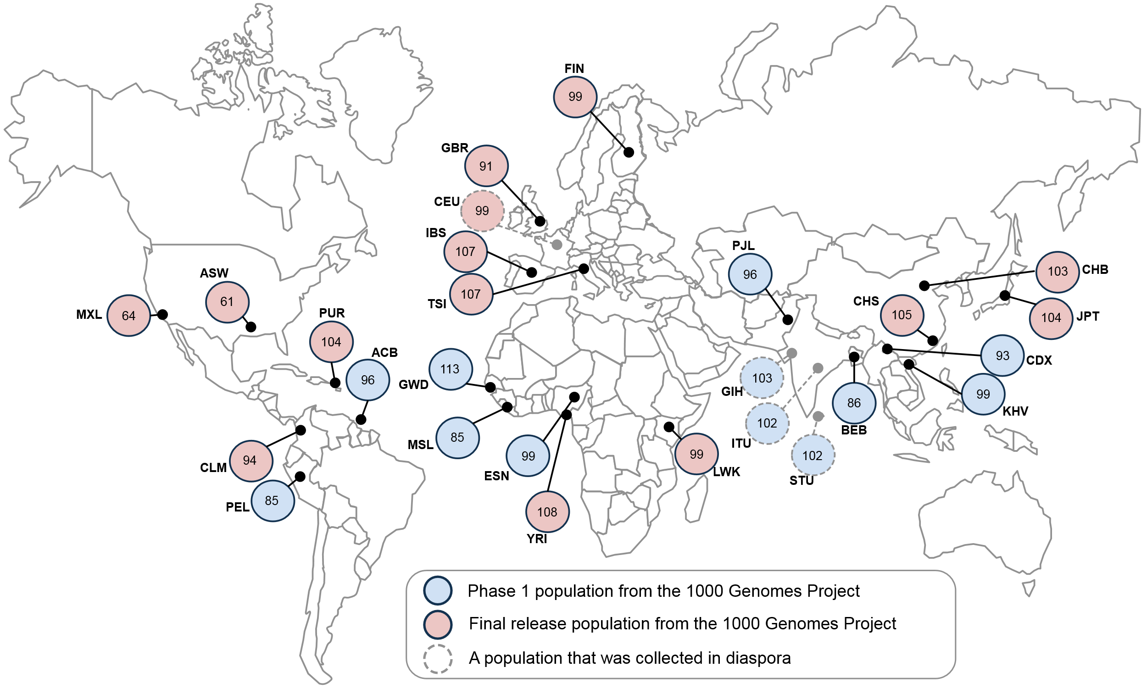
1000 Genomes Project
Established in 2008 to create a catalog of human genetic variation
https://en.wikipedia.org/wiki/1000_Genomes_Project#/media/File:1000_Genomes_Project.svg

Slide 3
1000G Ancestral populations
26 populations
CEU: Utah Residents (CEPH) with Northern and Western European Ancestry
YRI: Yoruba in Ibadan, Nigeria
CHB: Han Chinese in Bejing, China
http://ftp.1000genomes.ebi.ac.uk/vol1/ftp/phase3/20131219.populations.tsv
Five Super Populations EAS, EUR, AFR, AMR and SAS
http://www.internationalgenome.org/faq/which-populations-are-part-your-study/
http://ftp.1000genomes.ebi.ac.uk/vol1/ftp/phase3/20131219.superpopulations.tsv

Slide 4
IGSR: The International Genome Sample Resource
http://www.internationalgenome.org/
“The International Genome Sample Resource (IGSR) was established to ensure the ongoing usability of data generated by the 1000 Genomes Project and to extend the data set.”
Provides paired-end germline sequencing data from 1000G participants
Data: http://www.internationalgenome.org/data

Slide 5
dbSNP:
Database for short genetic variations
53 organisms (no-human genomes not supported after 09/01/2017
https://www.ncbi.nlm.nih.gov/projects/SNP/index.html
https://www.ncbi.nlm.nih.gov/projects/SNP/snp_ref.cgi?rs=3761685

Slide 6
COSMIC
COSMIC: Catalogue Of Somatic Mutations In Cancer
http://cancer.sanger.ac.uk/cosmic
Expert Curation
Drug Resistance
Cancer Gene Census
Curated Genes
Gene Fusions
Genome-Wide Screens
Must register to get COSMIC vcf file

Slide 7
HG00096
For the tutorial, we will use sequencing reads from sample HG0006
http://www.internationalgenome.org/data-portal/sample/HG00096
http://ftp.1000genomes.ebi.ac.uk/vol1/ftp/phase3/data/HG00096/sequence_read/
We will fetch reads using SRA for tutorial

Slide 8
The European Bioinformatics Institute (EMBL-EBI)
Study: PRJEB3366
RNA-Seq of 465 lymphoblastoid cell lines (LCL) from the 1000 Genomes
CEU, FIN, GBR, TSI and YRI populations
http://www.ebi.ac.uk/ena/data/view/PRJEB3366
Can be used to study the relationship between genetic variation and the transriptome (among other things)

