Slide 1

Internet Marketing Analysis
Team 1
  Laura Brinn
  Ed Dinicola
  Earle Gregory
  Guy Shechter

Slide 2
Data Review for Context
Publisher
    Publisher ID
    Publisher Name
Keyword Strategy
    Campaign
    Keyword Group
    Keyword ID
    Keyword
    Match Type
    Category
    Bid Strategy
    Keyword Type
    Status
Results/Possible Metrics
    Search Engine Bid
    Avg. Position
    Impressions
    Clicks
    Engine Click Thru %
    Click Charges
    Average Cost Per Click
    Amount (Sales Revenue)
    Total Cost
    Total Volume of Bookings
    Trans Conv %
    Total Cost/ Transaction
    Net revenue (added)
    ROA (added)
Notes:
[Refers to Case Question 1]
We review the data before constructing any pivot tables so we could better organize our approach given the number of variables involved. We broke the variables into main categories “Keyword Strategy” and “Results”.
Given the focus in the case on net revenue and ROA, we added those (though we figured out how to calculate these automatically within the pivot table later using formulas embedded in the pivot table.) Using these values makes sense as they both give a view of performance that summarizes many of the other metrics into one number, particularly ROA. [Refers to Case Question 1]
So we expected that using pivot tables would show us that different combinations of Keyword Strategy components would produce different performance Results and these observations would guide our recommendation..

Slide 3
AIDA Framework
Awareness
Interest
Action
Desire
Click through rate
Net Revenue
Return on Advertising
Click through rate
Clicks / Costs
Impressions / Costs
Notes:
After reviewing the data we had we then thought about the different goals of advertising and the possible strategies to deliver on these goals. We decided to use the AIDA framework from our marketing class to help guide our analysis.
[Refers to Case Question 1]
While there are lots of possible metrics we could focus on, using the AIDA framework we identified a few that we thought best indicated performance for that stage of the marketing process. Depending on an advertiser’s goal, different metrics might be a focus.
Awareness > Impressions (amount of times an ad is shown) can help build brand awareness
Interest/Desire > Click cost and CTR indicate progress moving prospects towards a sale
Net Revenue > Revenue minus Costs
ROI > (Revenue – Cost)/Cost we expected this would be the best metric to guide investment while balancing against the current net revenue success of existing campaigns

Slide 4
AIDA Framework & Key Metrics
Interest & Desire
Awareness
Action
Notes:
To begin our analysis, we review each publisher though each phase of the AIDA framework. Each table here shows the top performers for each phase. We attempted to normalize the numbers using cost since the amount spent with each publisher varied greatly but we still wanted to compare relative performance. As you can see, different publishers excel in different areas so spending could be allocated differently depending on the advertiser’s goals. We chose to focus on both net revenue and ROA as the main guide for strategic recommendations.

Slide 5
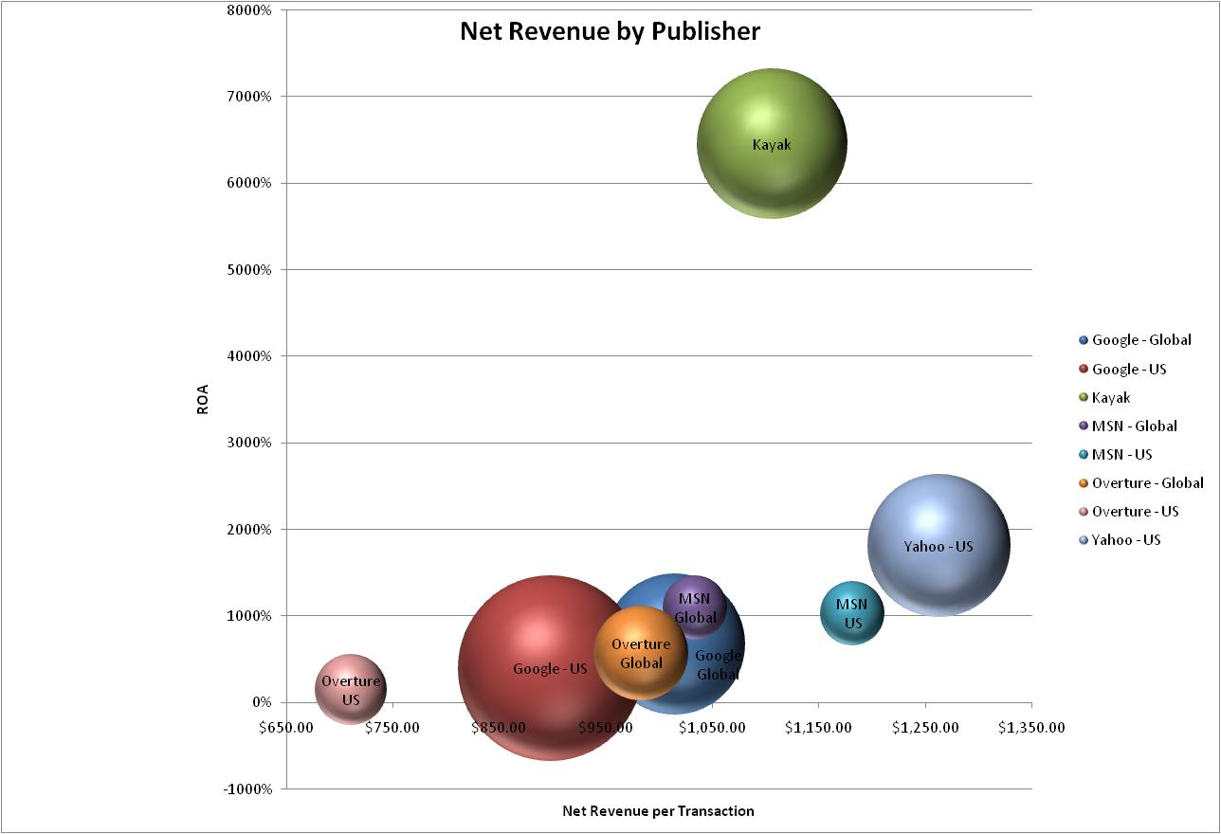
Notes:
[Refers to Case Question 2]
At this point we wanted to try and understand the relationship between our chosen key metrics: net revenue, net revenue by transaction and ROA. While we wanted to focus purely on ROA, we could not ignore the sales successes indicated by our net revenue and net revenue per transaction analysis.

Slide 6
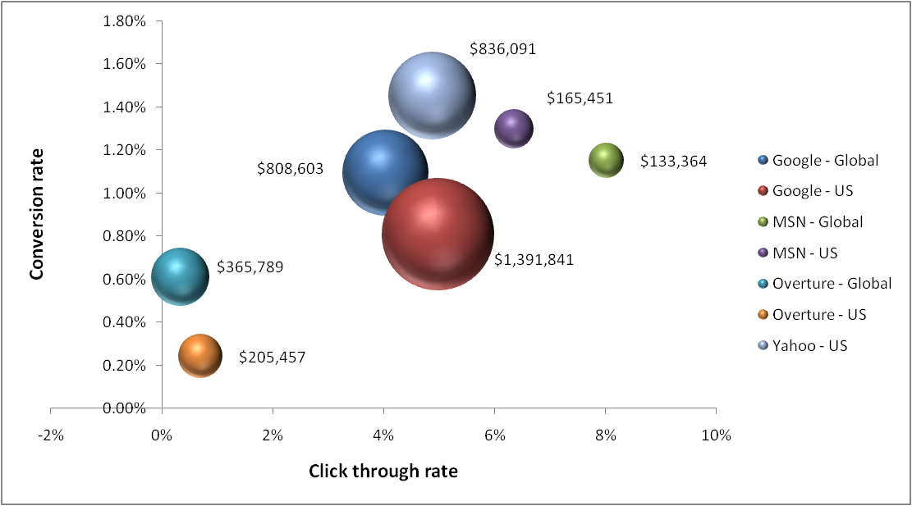
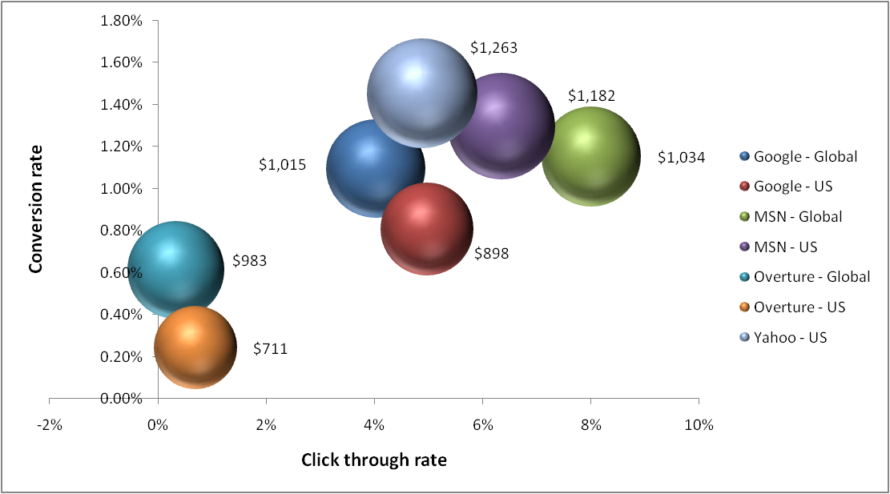
Net revenue
Net revenue per transaction
Notes:
[Refers to Case Question 4 and Case Question 2]
In addition to ROA we also drilled down further into net revenue. What we saw was that those with the highest net revenue did not necessarily have the highest net revenue per transaction. And some with low net revenue had higher click through and conversion rate. Since (total) net revenue is directly dependent on spending (cost), this observation immediately suggested possible spending shifts to those with higher conversion and click through rates, such as MSN. To get more granular, we then looked at net revenue per transaction and found that publishers such as Google – US who has the largest net revenue, does not have the nest net revenue per transaction. This suggests that while a publisher might have the highest net revenue it might not be generating the best return for the advertiser.

Slide 7
Publisher Recommendations
Shift investments into MSN Global and MSN US
Decrease spending on Overture US
Increase investment in Yahoo US
Shift using an incremental, phased approach to test performance over time
Notes:
[Refers to Question 2]
Decrease spending on Overture US b/c it generates many impressions but does not convert into enough sales and ROA
Shift investments into MSN Global and MSN US since ROA is high for both and net revenue could be greater with increased spending
Increase investment in Yahoo - US in order to increase overall net revenue (has high conversion rates but low initial investment relative to others)

Slide 8
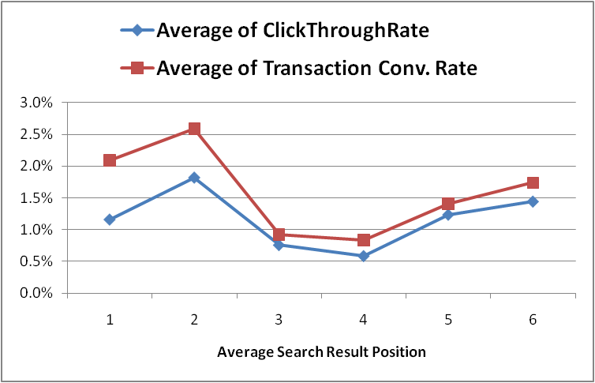
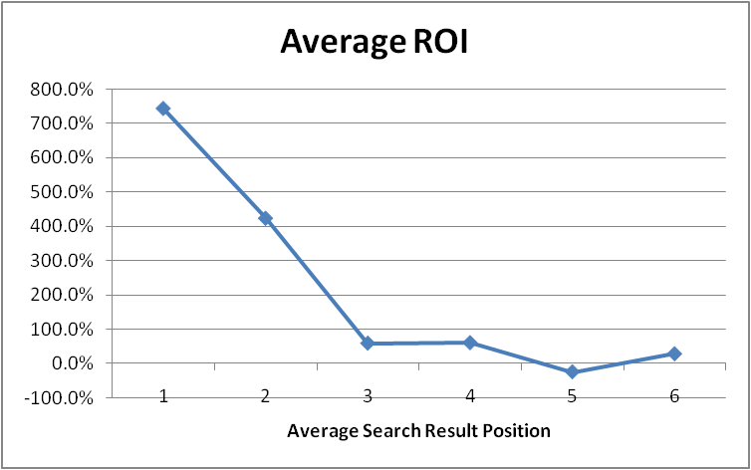
Position, CTR, & Conversion Rate
Notes:
[Refers to Case Question 3]
Beyond the publisher analysis, we wanted to explore the options more deeply so we began to look more at specific key word strategy factors.
One aspect that we wanted to explore was the possible relationship between search result position, click through rate, and conversion rate and how these metrics affected ROI. First we had to transform the search result position from a real number into an integer and then we placed these into “position buckets” so we could compare more effectively using a pivot table. As you can see, the higher (closer to 1) in the list a keyword/ad is shown, the higher the click through rate, conversation rate, and in turn, ROI. This suggest a bidding strategy that may be willing to pay more for higher placement.

Slide 9
Bid Position and Match Type
Google Global: Shift more into exact match with position 1-3 bid strategy
Google US: Shift more into broad match with position 1-2 bid strategy
MSN Global: Stay focused on broad match with position 1-4 bid strategy
Overture Global: Shift more into advanced match with position 1-2 bid strategy
Overture US: Shift more into standard match with position 1-4 bid strategy
Notes:
[Refers to Case Question 3]
In this analysis, we build multiple pivot tables to explore possible relationships among keyword strategy factors (slide 2) and their impact on ROA. Ultimately, we found the most valuable insights from a review of bid position and keyword type on ROA within publishers. Since each publisher has different big strategy and keyword match categories, this approach would not be used to make spending shift recommendations among publishers, only within a publishers. The light green boxes indicate areas of highest ROA within a publisher and given our assumption that ROA is the most critical factor, publishers should shift spending from lower ROA campaigns into these higher ROA categories. (The first column of ROA %ages was not labeled with any bid strategy in the data set. This is unfortunate as it has some of the highest ROA values and thus evaluating the bid strategy for this is difficult.) Since Google US currently has the highest amount of advertiser spend out of this group, we decided to explore the specific details of the two highest ROA categories, indicated in bright green on the chart.

Slide 10

Keyword Analysis
Notes:
(Related to Case Question 3]
Since we are recommending a shift of spending into specific bid position strategy/match type groups, we used a pivot table to explore two of these this specific categories to see if any improvements could be made. In the “Position 1-2 Target/Broad Match” group, we found that some keywords have a negative ROA and should not be invested in further. The others in bright green should receive the increased investment. Interestingly, the other group we reviewed in detail contained only one keyword! This one keyword however has a very high ROA and should be invested in. Many other combinations of factors were explored but this simple sorted ROA view proved to be the most helpful to our team.

Slide 11
Conclusions and
Q & A

