Slide 1
Social Networks & Health
Part 2
Moody, James, Lisa A. Keister, M. Giovanna Merli “Focused Training in Social Networks and Health” NICHD, 2 R25 HD079352-06

Slide 2
Social Networks & Health
Outline
Part 1: Introduction & Theory
History & Big Picture
Network Relevance to Health Research
Network Theory
Connections & Positions
Part 2: Points & Lines
Network data
Visualization
Network metrics
Part 3: Network Models
Diffusion
Disease
Network autocorrelation
Random Graph Models
SOAM
Open Questions

Slide 3
Social Network Data
The unit of interest in a network are the combined sets of actors and their relations.
We represent actors with points and relations with lines.
Actors can be referred to as nodes, vertices, or points
Relations can be referred to as edges, arcs, lines, or ties
Example:
b
d
a
c
e

Slide 4
Social Network Data
In general, a relation can be:
Binary or Valued
Directed or Undirected
b
d
b
d
a
c
e
a
c
e
undirected, binary
directed, binary
b
d
b
d
1
3
1
2
a
c
4
e
a
c
e
undirected, valued
directed, valued

Slide 5
Social Network Data
Basic Data Elements
In general, a relation can be: (1) Binary or Valued; (2) Directed or Undirected
b
d
a
c
e
Directed,
Multiplex categorical edges
The social process of interest will often determine what form your data take. Conceptually, almost all of the techniques and measures we describe can be generalized across data format, but you may have to do some of the coding work yourself….

Slide 6
Social Network Data
Basic Data Elements: Levels of Analysis
We can examine networks across multiple levels:
1) Ego-network
Have data on a respondent (ego) and the people they are connected to (alters).
May include estimates of connections among alters
2) Partial network
Ego networks plus some amount of tracing to reach contacts of contacts
Something less than full account of connections among all pairs of actors in the relevant population
Example: CDC Contact tracing data for STDs

Slide 7
Social Network Data
Basic Data Elements: Levels of Analysis
We can examine networks across multiple levels:
3) Complete or “Global” data
Data on all actors within a particular (relevant) boundary
Never exactly complete (due to missing data), but boundaries are set
Example: co-authorship data among all writers in the social sciences, friendships among all students in a classroom

Slide 8
Social Network Data
Basic Data Elements: Levels of Analysis
Global-Net
Primary
Group
Ego-Net
Best Friend
Dyad
2-step
Partial network

Slide 9
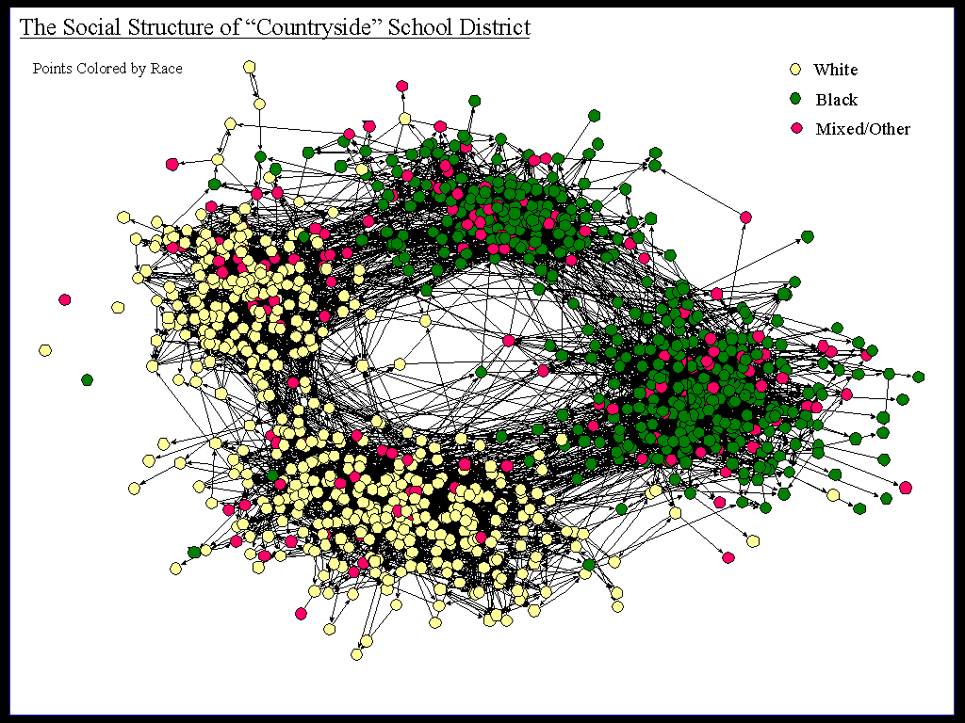
Social Network Data
Social network data are substantively divided by the number of modes in the data.
1-mode data represents edges based on direct contact between actors in the network. All the nodes are of the same type (people, organization, ideas, etc). Examples: Communication, friendship, giving orders, sending email.
This is commonly what people think about when thinking about networks: nodes having direct relations with each other.

Slide 10
Social Network Data
Social network data are substantively divided by the number of modes in the data.
2-mode data represents nodes from two separate classes, where all ties are across classes. Examples:
People as members of groups
People as authors on papers
Words used often by people
Events in the life history of people
The two modes of the data represent a duality: you can project the data as people connected to people through joint membership in a group, or groups to each other through common membership.
There may be multiple relations of multiple types connecting your nodes.

Slide 11
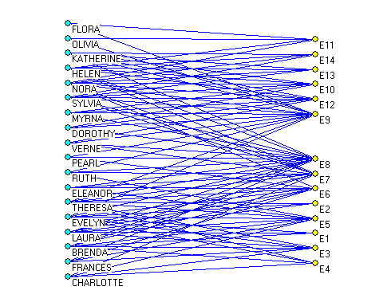
Social Network Data
Basic Data Elements: Modes
Bipartite networks imply a constraint on the mixing, such that ties only cross classes.
Here we see a tie connecting each woman with the party she attended (Davis data)

Slide 12
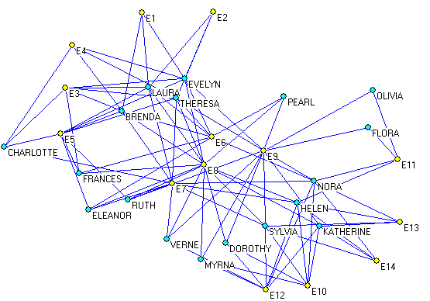
Social Network Data
Basic Data Elements: Modes
Bipartite networks imply a constraint on the mixing, such that ties only cross classes.
Here we see a tie connecting each woman with the party she attended (Davis data)

Slide 13
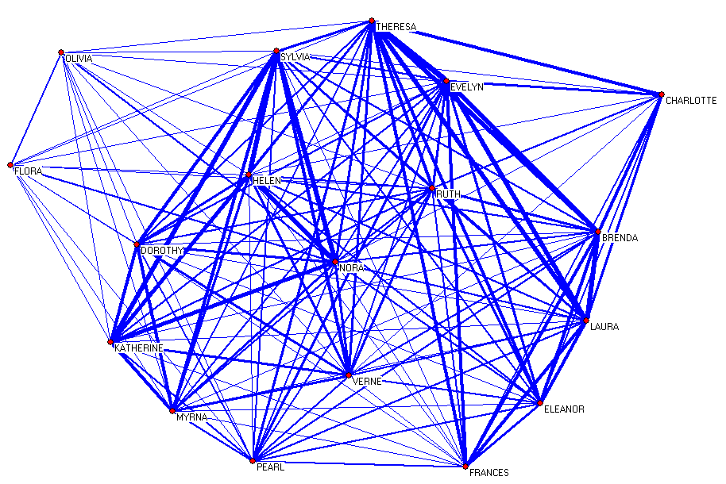
Social Network Data
Basic Data Elements: Modes
By projecting the data, one can look at the shared between people or the common memberships in groups: this is the person-to-person projection of the 2-mode data.

Slide 14
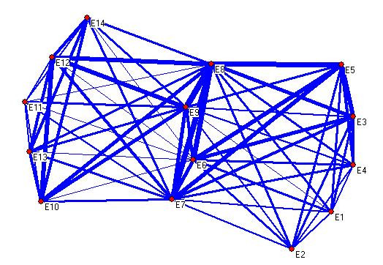
Social Network Data
Basic Data Elements: Modes
By projecting the data, one can look at the shared between people or the common memberships in groups: this is the group-to-group projection of the 2-mode data.

Slide 15
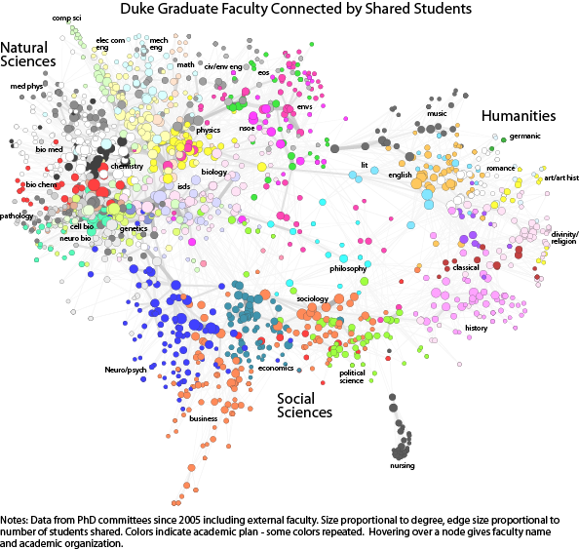
Social Network Data
Example of a 2-mode Network: Faculty Supervising Students
Any list of what people do – meetings, clubs, activities, co-authorship, – that they do with others forms network data.
Moody

Slide 16
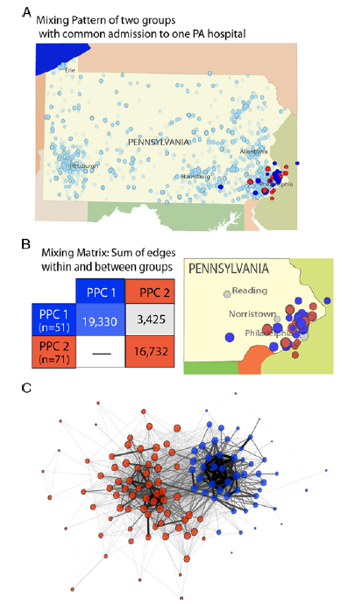
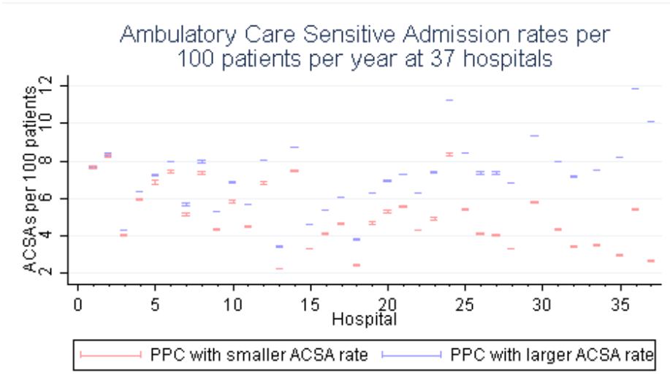
Social Network Data
Example of a 2-mode Network: Patients & Care Settings
Casalino, Lawrence P., Michael F. Pesko, Andrew M. Ryan, David J. Nyweide, Theodore J. Iwashyna, Xuming Sun, Jayme Mendelsohn and James Moody. “Physician Networks and Ambulatory Care Admissions” Medical Care 53:534-41
Notes:
"ambulatory care sensitive conditions" (ACSCs). ACSCs are conditions for which good outpatient care can potentially prevent the need for hospitalization, or for which early intervention can prevent complications or more severe disease. These are conditions for which good primary care may prevent admission. We used 12 conditions that met the AHRQ definition.
We examined fixed effects for each PPC, controlling for patient and physician characteristics. PPC fixed effects were jointly significant in the model at P < 0.01, suggesting that PPCs are associated with ACSA rates. The differences in performance were substantial. For example, compared to a mean number of ACSAs of 0.060 per beneficiary per year for all PPCs, the PPC at the 25th percentile of ACSA rates had 0.050 ACSAs per beneficiary, whereas the PPC at the 75th percentile had a 46% higher ACSA rate—0.073 per beneficiary
(data not shown).
On average, ACSA rates differed by 36% between PPCs that admit to the same hospital.

Slide 17
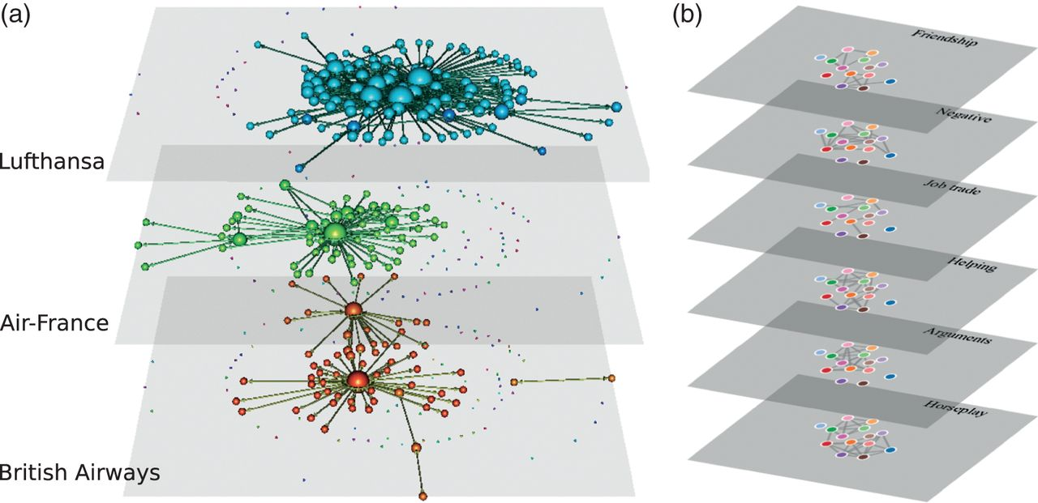
Social Network Data
Multi-Layer Networks
A recent generalization of multiplex networks and multi-mode networks is the multi-layer network. A multi-layer network is a network that has qualitatively different classes of nodes (like multi-mode networks) and qualitatively different types of relations (like multi-plex). Multiplex and multi-mode networks can be subsumed under the multi-layer formalism.
See Kivela, Mikko, Alex Arenas Marc Bartheelemy, James P. Gleeson, Yamir Moreno, and Mason Porter. “Multilayer Networks” Journal of complex Networks 2:203-271. https://doi.org/10.1093/comnet/cnu016

Slide 18
Social Network Data
Basic Data Structures
From pictures to matrices
b
d
The traditional way to store & represent network data is with an adjacency matrix.
The matrix (X) at right represents an undirected binary network. Each node (a-e) is listed on both the row and the column.
The i^{th} row and the j^{th} column (X_{ij}) records the value of a tie from node i to node j. For example, the line between nodes a and b is represented as an entry in the first row and second column (red at right).
Because the graph is undirected the ties sent are the same as the ties receive, so every entry above the diagonal equals the entries below the diagonal.
a
c
e
Undirected, binary
a
b
c
d
e
a
1
b
1
1
c
1
1
1
d
1
1
e
1
1
An undirected graph and the corresponding matrix is symmetric.

Slide 19
Social Network Data
Basic Data Structures
b
d
Directed graphs, on the other hand, are asymmetrical.
We can see that X_{ab} =1 and X_{ba} =1, therefore a “sends” to b and b “sends” to a. However, X_{bc}=0 while X_{cb}=1; therefore, c “sends” to b, but b does not reciprocate.
a
c
e
Directed, binary
a
b
c
d
e
a
1
b
1
c
1
1
1
d
e
1
1
A directed graph and the corresponding matrix is asymmetrical.

Slide 20
Social Network Data
Basic Data Structures
b
d
Directed graphs, on the other hand, are asymmetrical.
We can see that X_{ab} =1 and X_{ba} =1, therefore a “sends” to b and b “sends” to a. However, X_{bc}=0 while X_{cb}=1; therefore, c “sends” to b, but b does not reciprocate.
a
c
e
Directed, Valued
a
b
c
d
e
a
1
b
3
c
1
2
4
d
e
2
1
A directed graph and the corresponding matrix is asymmetrical.

Slide 21
Social Network Data
Basic Data Structures
From matrices to lists (binary)
Social network analysts also use adjacency lists and arc lists to more efficiently store network data.
Arc List
a b
b a
b c
c b
c d
c e
d c
d e
e c
e d
a
b
c
d
e
Adjacency List
a
1
b
d
a b
b a c
c b d e
d c e
e c d
b
1
1
a
c
e
c
1
1
1
d
1
1
e
1
1
Notes:
Notice that the adjacency list states that a is tied to b and b is tied to a and c. The arc list merely lists all of the tied nodes or relationships.

Slide 22
Social Network Data
Basic Data Structures
From matrices to lists (valued)
Social network analysts also use adjacency lists and arc lists to more efficiently store network data.
Arc List
a b 1
b a 1
b c 2
c b 2
c d 3
c e 5
d c 3
d e 1
e c 5
e d 1
a
b
c
d
e
Adjacency List
a
1
contact
value
1
b
2
3
d
1
a b
b a c
c b d e
d c e
e c d
a 1
b 1 2
c 2 3 1
d 3 1
e 5 1
b
1
2
a
c
5
e
c
2
3
5
d
3
1
e
5
1
Notes:
Notice that the adjacency list states that a is tied to b and b is tied to a and c. The arc list merely lists all of the tied nodes or relationships.

Slide 23
Social Network Data
Basic Data Structures
Working with Two-Mode Data
A person-to-group adjacency matrix is rectangular, with one mode (persons, say) down rows and the other (groups, say) across columns
Each column is a group, each row a person, and the cell = 1 if the person in that row belongs to that group.
You can tell how many groups two people both belong to by comparing the rows: Identify every place that both rows = 1, sum them, and you have the overlap.
1 2 3 4 5
A 0 0 0 0 1
B 1 0 0 0 0
C 1 1 0 0 0
D 0 1 1 1 1
E 0 0 1 0 0
F 0 0 1 1 0
A =
P = A(A^{T}) = person to person projection
G = A^{T}(A) = group to group projection

Slide 24
Exploratory Analysis: Visualization

Slide 25
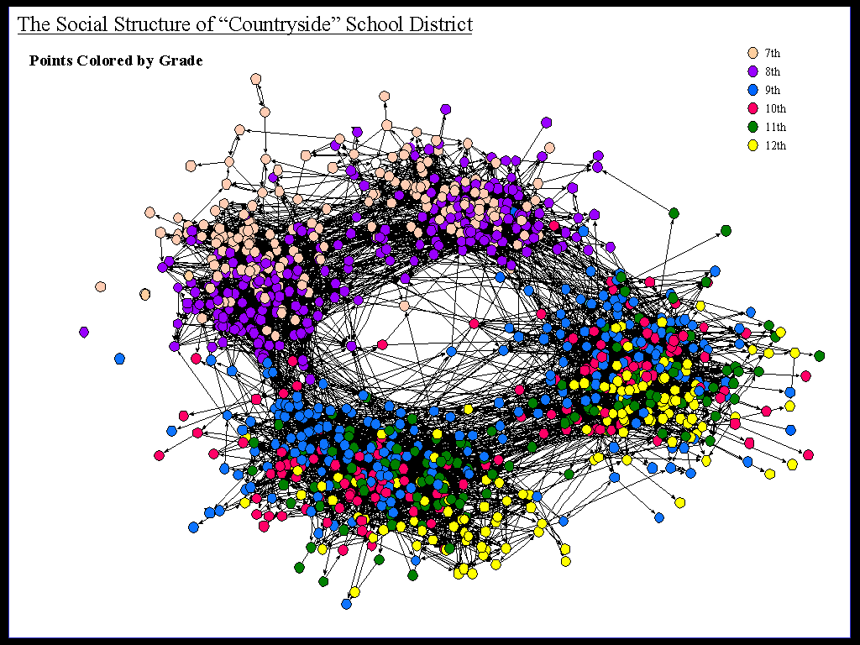
Exploratory Analysis: Visualization
One of the first analysis tasks one undertakes is to visualize the network. This gives you a chance to gut-check the data, make sure nothing looks terribly out of place and start exploring key “shape” functions of the setting.
A good visualization can go along way toward building intuition about what features are shaping the network. This is a very deep field, we’re just going to touch on enough to get you started.

Slide 26
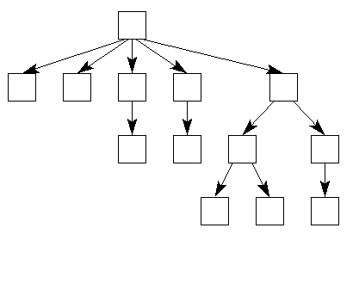
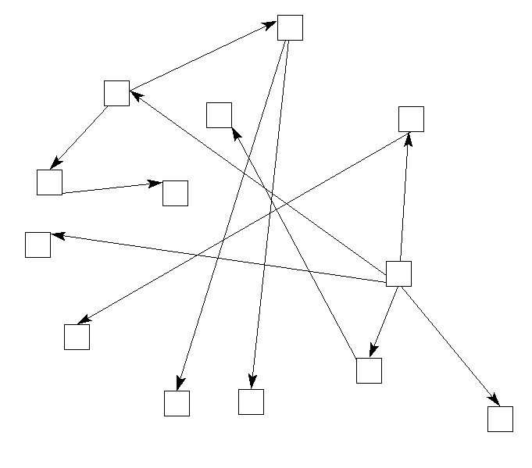
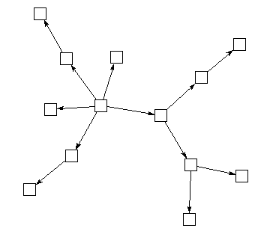
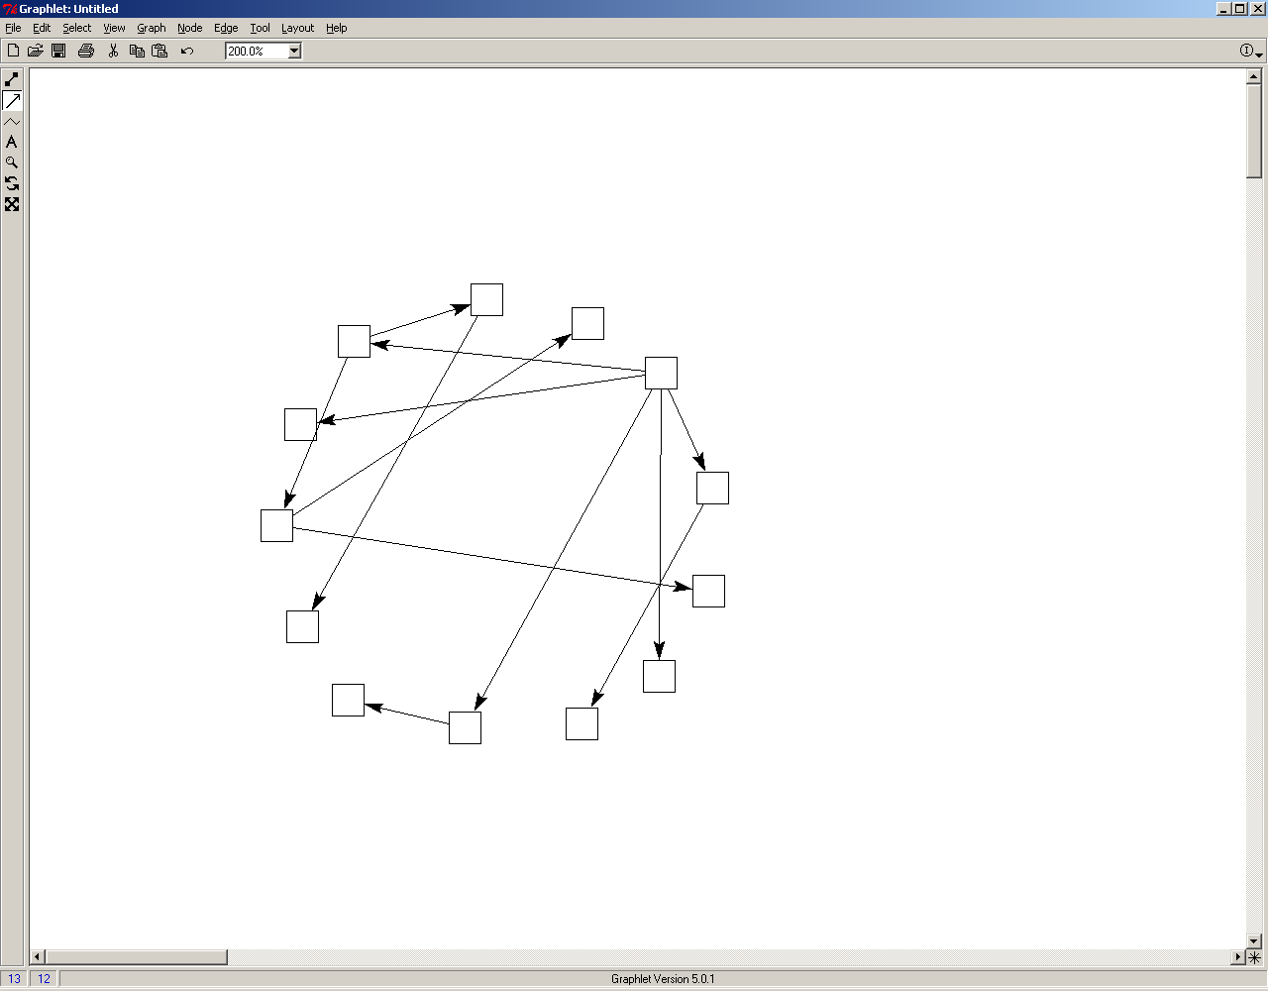
Exploratory Analysis: Visualization
A good network drawing allows viewers to come away from the image with an almost immediate intuition about the underlying structure of the network being displayed.
However, because there are multiple ways to display the same information, and standards for doing so are few, the information content of a network display can be quite variable.
Consider the 4 graphs drawn at right.
After asking yourself what intuition you gain from each graph, click on the screen.
Now trace the actual pattern of ties. You will see that these 4 graphs are exactly the same.

Slide 27
What Makes a Good Visualization?
Unlike a scatter-plot, the default layout styles of most off-the-shelf programs will lead to very different layouts:
Visualization
Strategy
Data
Fidelity
Knowledge
problem
Visualization as craft: My instinct is that hard-and-fast rules will be difficult to find, craft production is thus a better model than either art (too expressive) or technical drawing (too rigid).
Let’s work through some exemplars and see how they balanced these trades

Slide 28
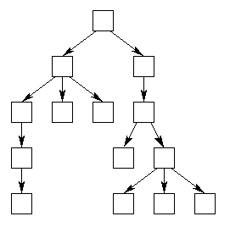
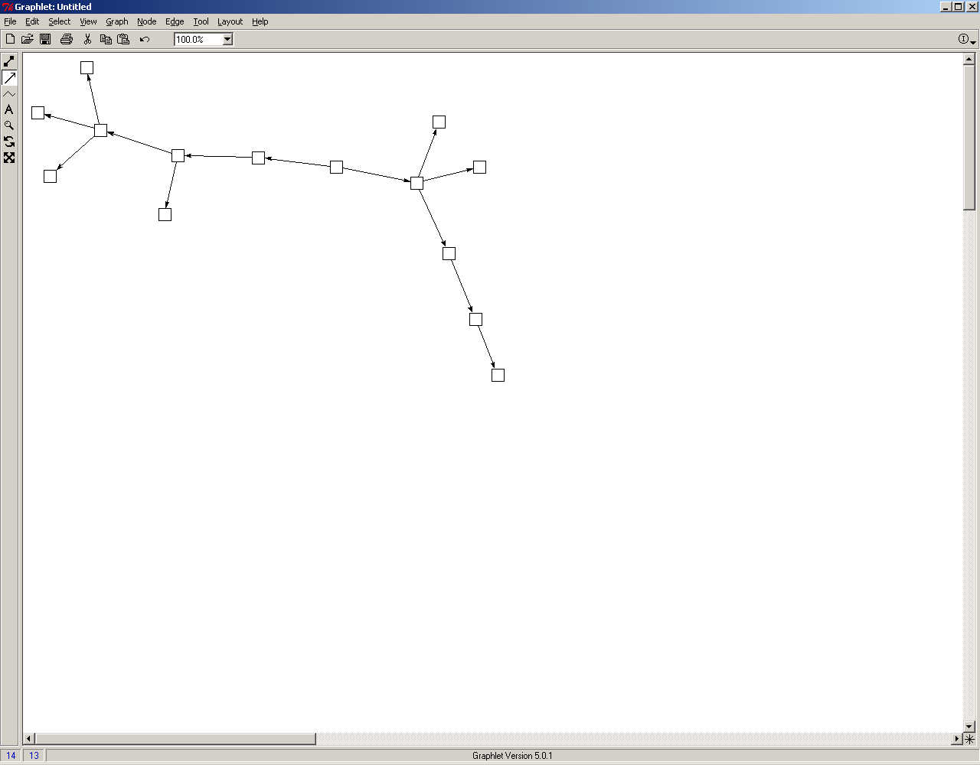
Basic Layout Heuristics
Network visualization helps build intuition, but you have to keep the drawing heuristic. Here we show the same graphs with two different techniques:
Tree-Based layouts
“Force” layouts
(good)
(Fair - poor)
Most effective for very sparse, regular graphs. Very useful when relations are strongly directed, such as organization charts, cluster tress or internet connections.
Most effective with graphs that have a strong community structure (clustering, etc). Provides a very clear correspondence between social distance and plotted distance
Two images of the same network

Slide 29
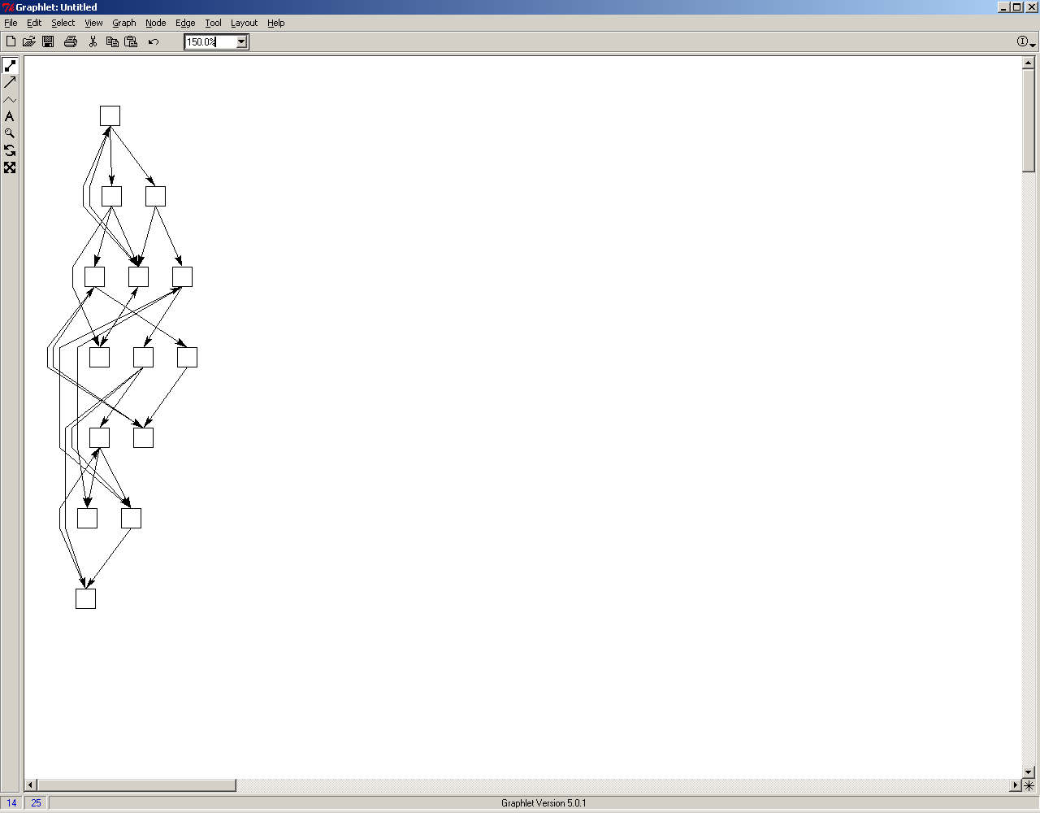
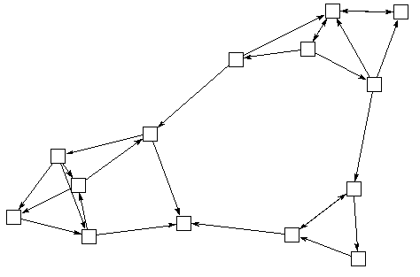
Basic Layout Heuristics
Network visualization helps build intuition, but you have to keep the drawing heuristic. Here we show the same graphs with two different techniques:
Tree-Based layouts
“Force” layouts
(poor)
(good)
“good” = high correlation between spatial distance and network distance.
Two layouts of the same network

Slide 30
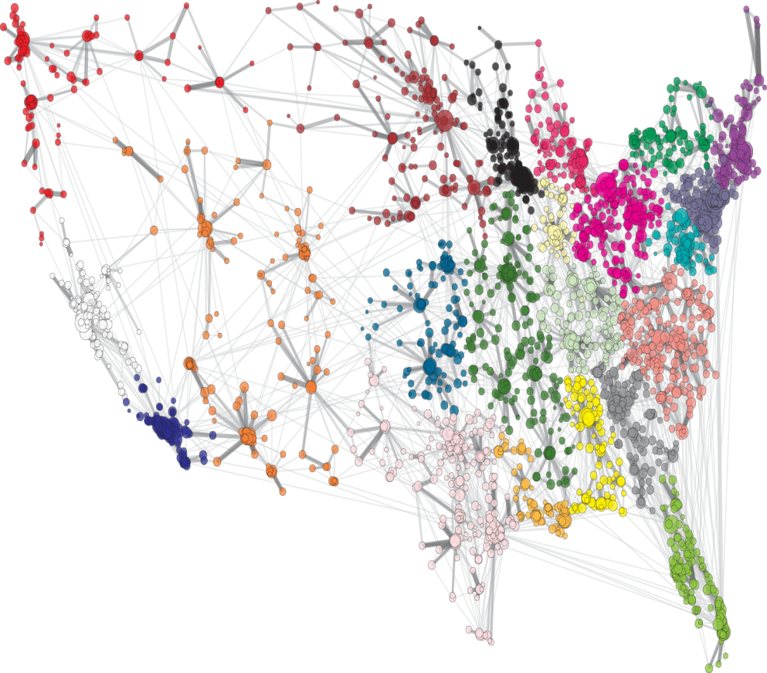
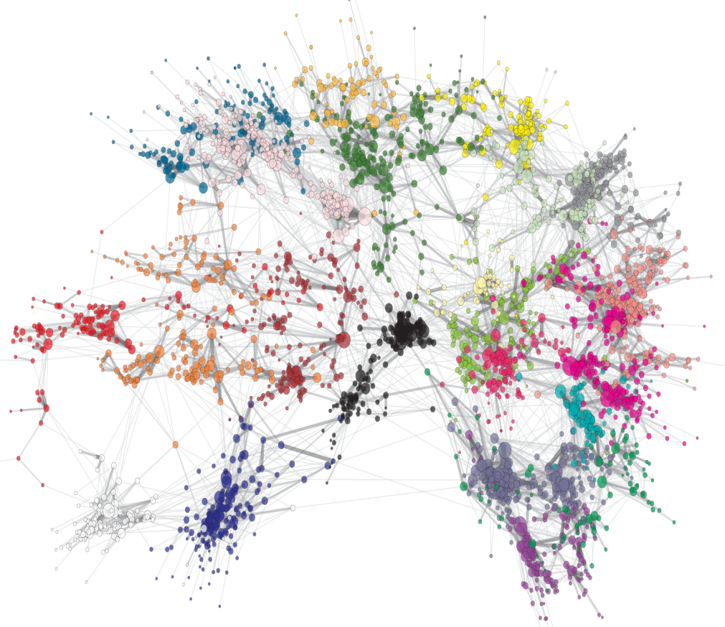
Basic Layout Heuristics
Network visualization helps build intuition, but you have to keep the drawing heuristic. Here we show the same graphs with two different techniques:
Fixed Coordinate Layouts
Fit: 0.528
Fit: .682
Two layouts of the same network

Slide 31
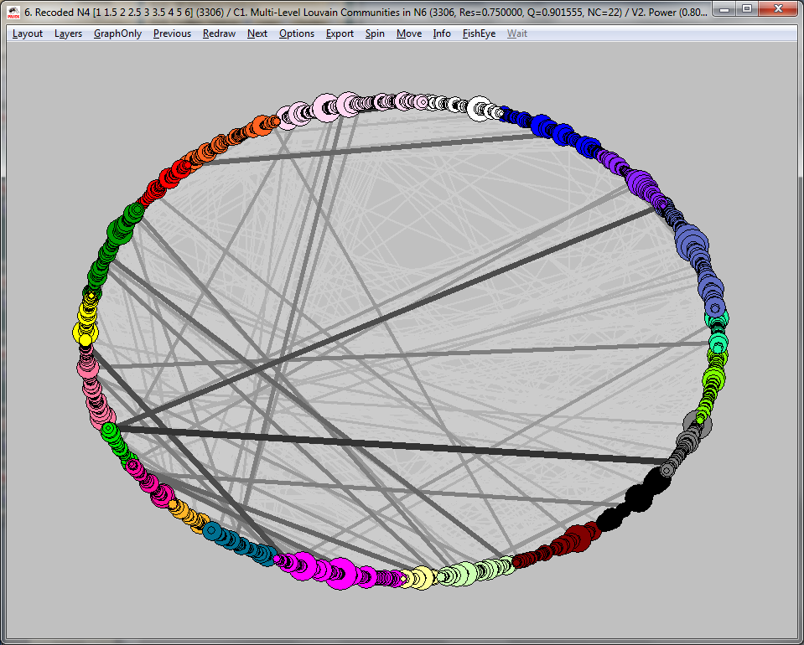
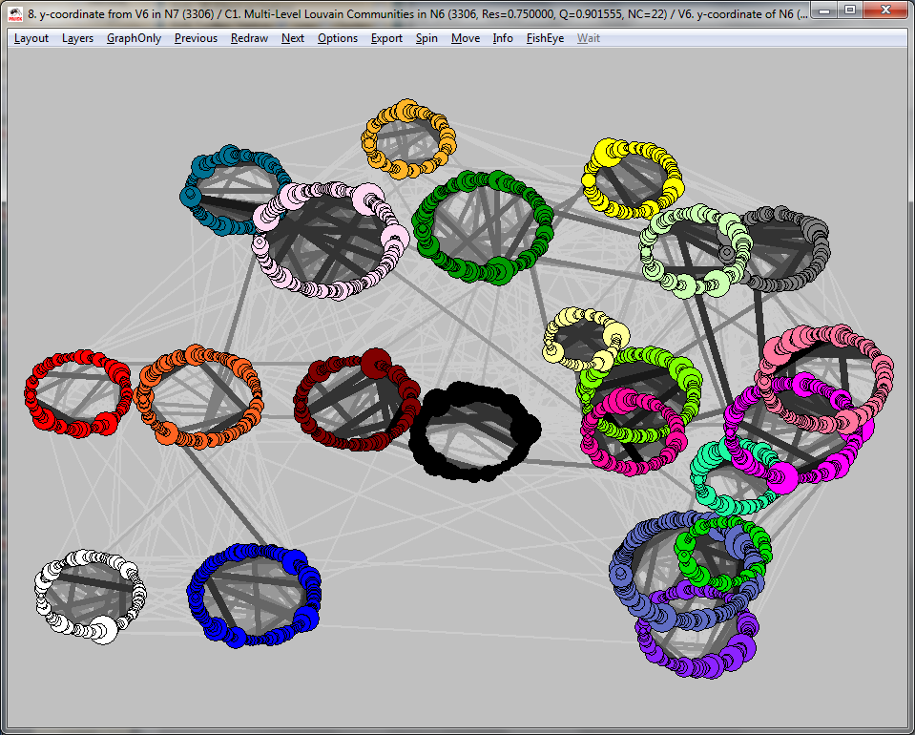
Basic Layout Heuristics
Network visualization helps build intuition, but you have to keep the drawing heuristic. Here we show the same graphs with two different techniques:
Fixed Coordinate Layouts
Fit=0.26
Fit=0.57
Two layouts of the same network

Slide 32
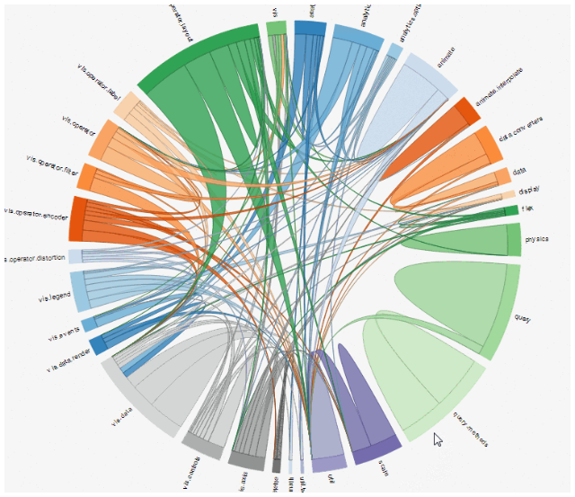
Basic Layout Heuristics
Fixed Coordinate Layouts
Chord diagrams are the network equivalent of pie charts. Avoid them.
Fixed Coordinate Layouts

Slide 33
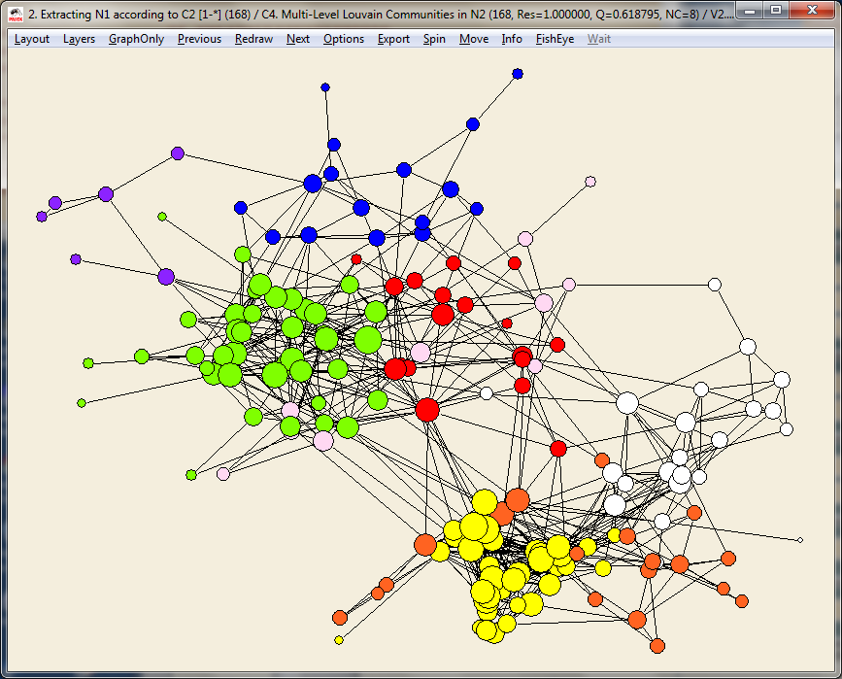
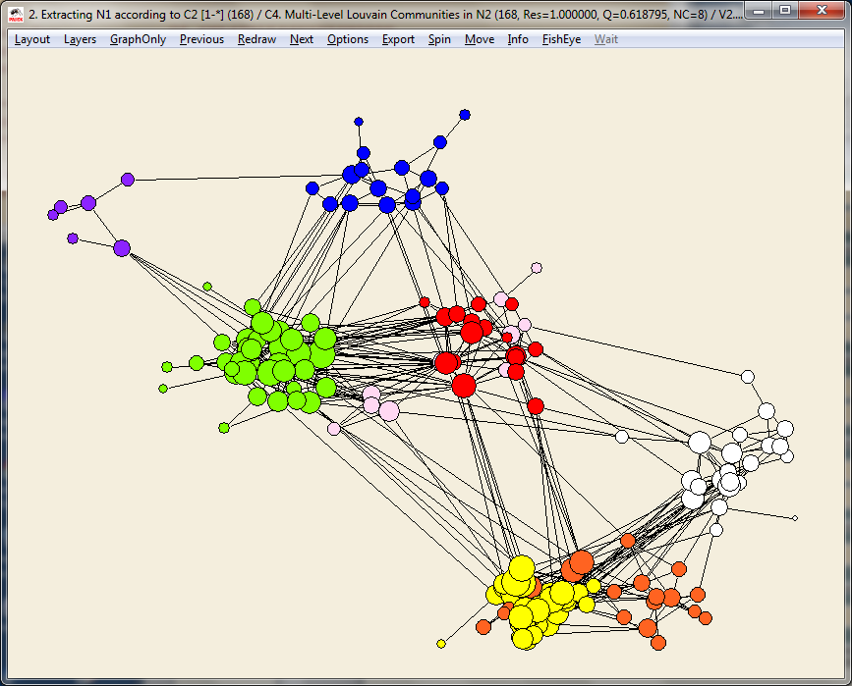
Basic Layout Heuristics
Levels of Distortion?
Network visualization helps build intuition, but you have to keep the drawing heuristic. Here we show the same graphs with two different techniques:
Fit=0.81
Fit=0.75
Shrink each cluster to accent separation
Two layouts of the same network

Slide 34
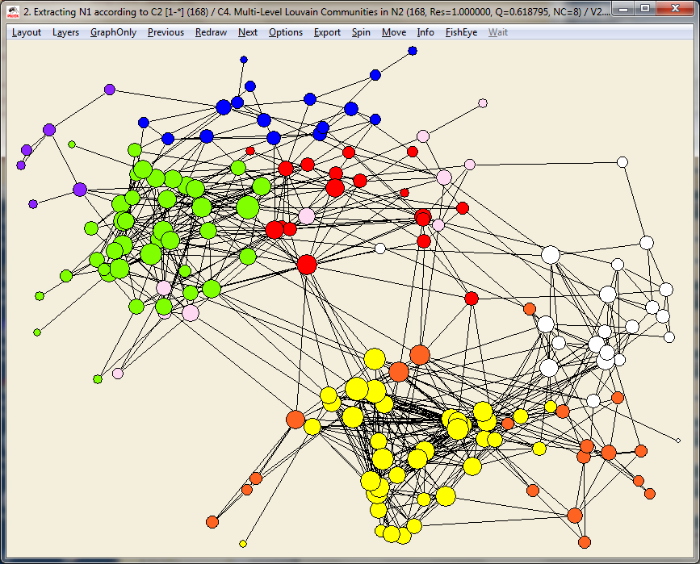
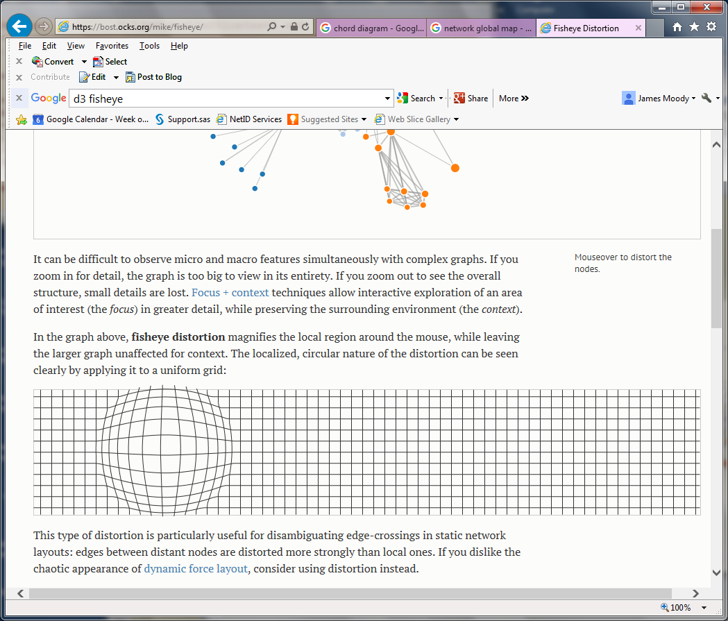
Basic Layout Heuristics
Network visualization helps build intuition, but you have to keep the drawing heuristic. Here we show the same graphs with two different techniques:
Fit=0.81
Fit=0.74
Center fisheye on dense cluster

Slide 35
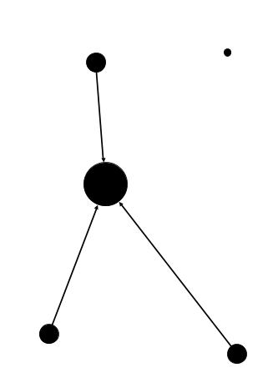
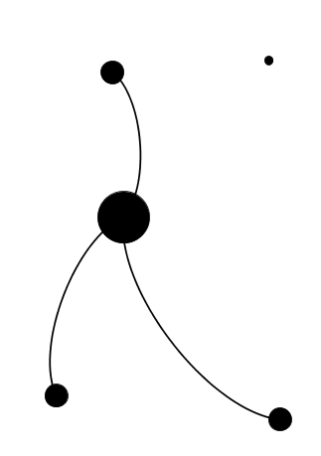
Secondary style elements
Some seemingly innocuous features can shape the effect of network diagrams
Use curves sparingly…they are usually useless – just extra ink – it’s a hallmark of the default Gephi style...and in Gephi is used to signal direction (out-ties curve to the left)…but else doesn’t add much.

Slide 36
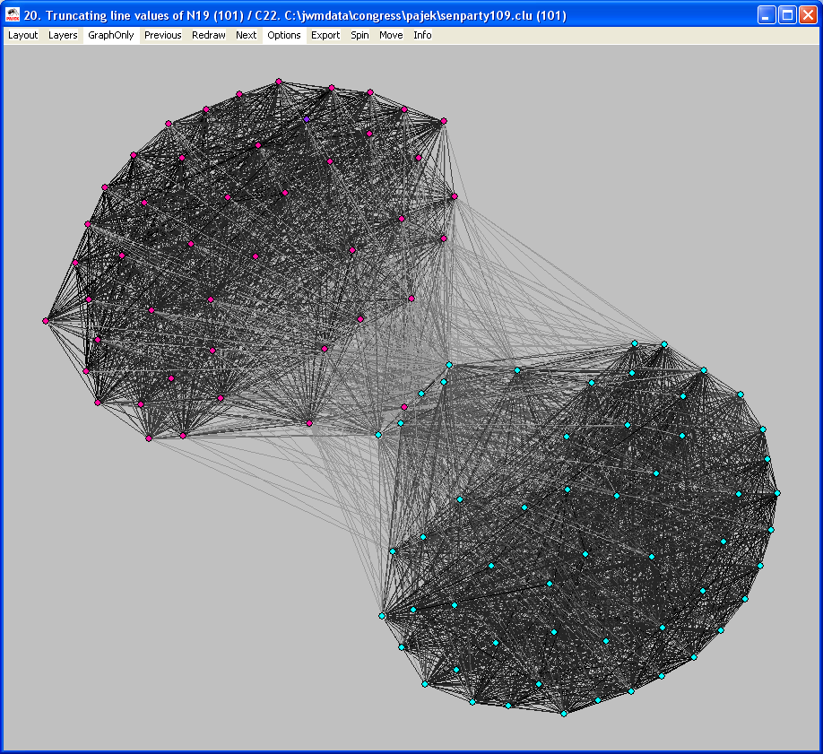
Basic Problem 1: Density/Scale
Abstraction helps – consider dense networks
Co-voting similarity, 109th senate

Slide 37
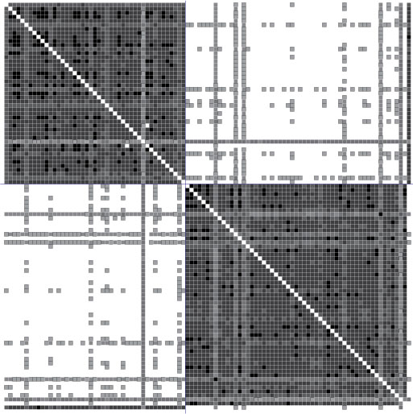
Basic Problem 1: Density/Scale
Abstraction helps – consider dense networks
Co-voting similarity, 109th senate
See also: https://bost.ocks.org/mike/miserables/
Notes:
The art analogy I have in mind is the contrast of, say, painting to music – music is creative within levels of constraint – defined by key, time signature, rule of harmony, etc. These can be violated, but the ability to pull that off is a skill – bad violations of harmony rules are amiturish, good ones are the mark of creativity.
The 3 featuers are actually 4, since “spread” and “space” are distinct.

Slide 38
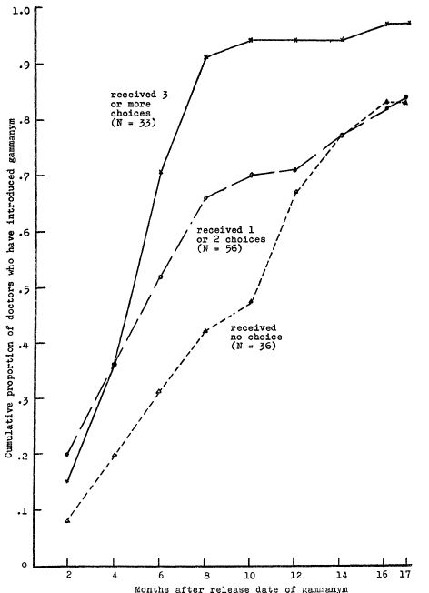
Basic Problem 2: Spread over a dynamic network
The traditional network diffusion image is the logistic curve. Consider Coleman, Katz and Menzel (1957):
These curves count the cumulative number of “adopters” by time, but don’t express much about network structure, because they aggregate across all transmissions.
That is, they show an aggregate outcome without really identifying a social process.

Slide 39
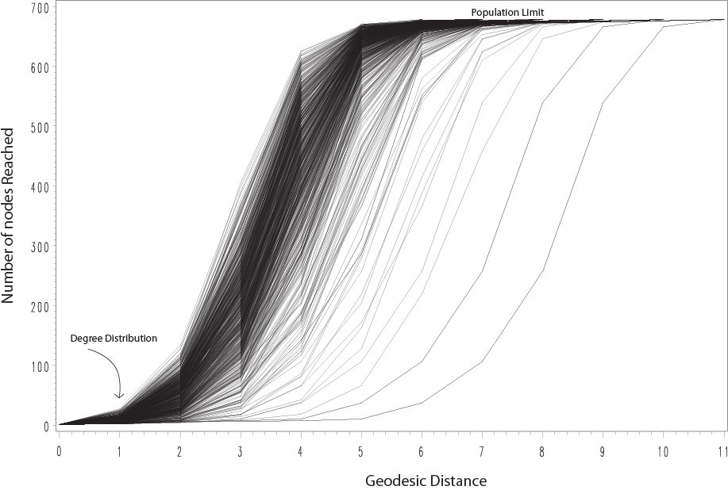
Basic Problem 2: Spread over a dynamic network
An alternative is to think of a network trace as the likely number reached from any given node, where “likely” is determined either by an edge transmission p(transfer|dist) or simple distance (geodesic), and follow each starting node.
Trace Curves: Number reachable at each step
The collection of curves is useful, to either compare to a null hypothesis or to contextualize an observed epidemic. Curves are simple to use, as we have good statistical measures of their shape.
But they are still one-step removed from the network itself, so how might we incorporate this information into the network?
Notes:
This can then be used to contextualize a particular node trace (such as the observed contact tracing from a first mover)

Slide 40
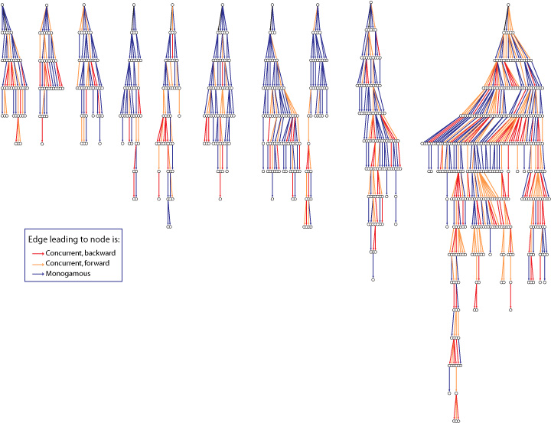
Basic Problem 2: Spread over a dynamic network
Start with Context: Now follow only the diffusion paths
Tree Based Layout.
Since concurrency is an edge property, we color the edges by the concurrency status of the tie…
Notes:
A key part of the story is that transmission is facilitated by concurrent edges, so we color the network edges by concurrency…

Slide 41
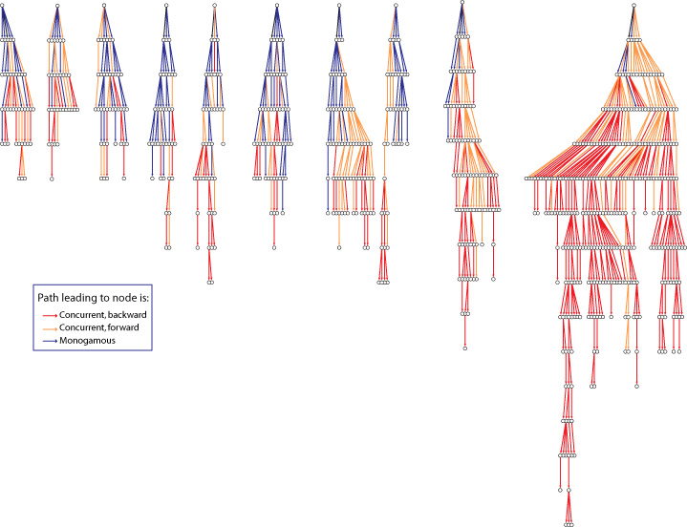
Basic Problem 2: Spread over a dynamic network
Start with Context: Now follow only the diffusion paths
Tree Based Layout.
..but since the path carries the infection, we highlight the cumulative effect of concurrency by noting any place where a transmission would have been impossible were it not for an earlier concurrent edge.
This is one way to deal with the importance of network dynamics.
Notes:
A key part of the story is that transmission is facilitated by concurrent edges, so we color the network edges by concurrency…

Slide 42
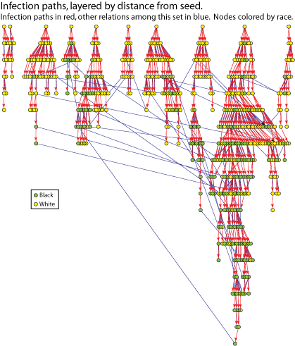
Basic Problem 2: Spread over a dynamic network
Start with Context: Now follow only the diffusion paths
An alternative version, here including non-transmission edges amongst the transmission set.
Notes:
A key part of the story is that transmission is facilitated by concurrent edges, so we color the network edges by concurrency…

Slide 43
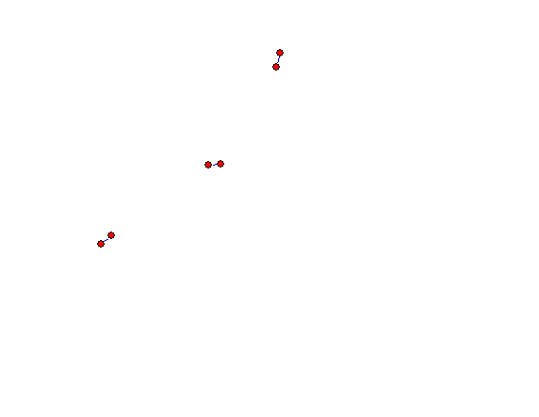
Basic Problem 3: Dynamic network Evolution
Adding time to social networks is also complicated, as you run out of space to put time in most network figures.
One solution is to animate the network.
When the network is very sparse, sometimes it makes more sense to build “layers” in a flipbooks style:

Slide 44
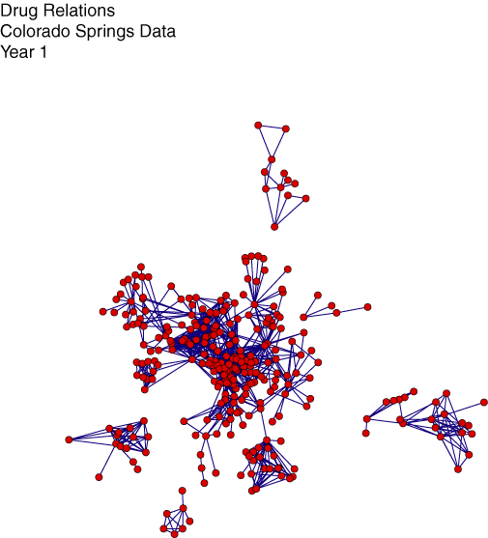
Basic Problem 3: Dynamic network Evolution
Data on drug users in Colorado Springs, over 5 years
Drug Relations, Colorado Springs, Year 1

Slide 45
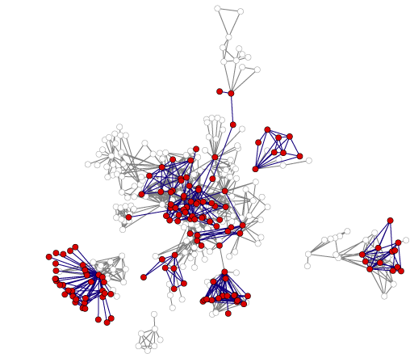
Basic Problem 3: Dynamic Network Evolution
Data on drug users in Colorado Springs, over 5 years
Drug Relations, Colorado Springs, Year 2
Current year in red, past relations in gray

Slide 46
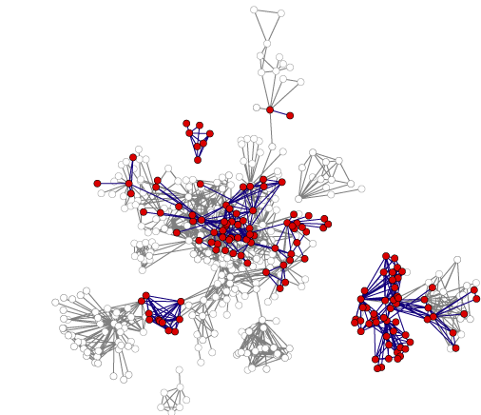
Basic Problem 3: Dynamic Network Evolution
Data on drug users in Colorado Springs, over 5 years
Drug Relations, Colorado Springs, Year 3
Current year in red, past relations in gray

Slide 47
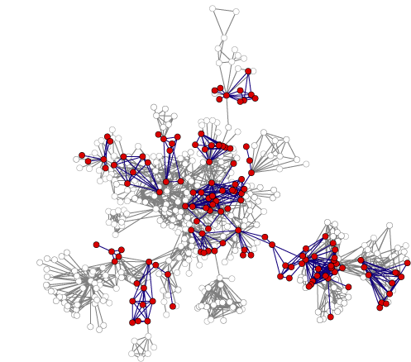
Basic Problem 3: Dynamic network Evolution
Data on drug users in Colorado Springs, over 5 years
Drug Relations, Colorado Springs, Year 4
Current year in red, past relations in gray

Slide 48
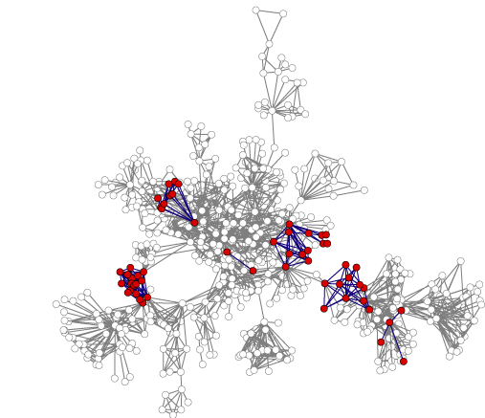
Basic Problem 3: Dynamic network Evolution
Data on drug users in Colorado Springs, over 5 years
In general, adding time to networks changes many of our notions of “structure” – which we’ll go through in detail later.
Drug Relations, Colorado Springs, Year 5
Current year in red, past relations in gray
Notes:
616 actors eventually part of the largest component
Diameter is 13 steps
There are a number of major bi-components, the largest having 214 members.

Slide 49
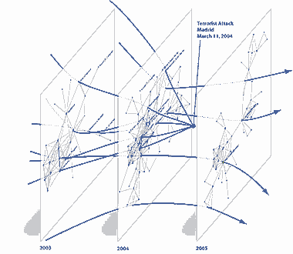
Basic Problem 3: Dynamic Network Evolution
Another way to represent time is by stacking relations against time:

Slide 50
Basic Problem 3: Dynamic Network Evolution
Another way to represent time is by stacking relations against time:

Slide 51
Basic Network Metrics
Much of network “analysis” is measuring a metric on the graph. These often define features that are then used as independent variables in a substantive analysis.
We next describe some of the most common basic elements; there are many alternatives and nuances to each…this is the tip of the iceberg.
Basic Volume (Degree, Density)
Reachability & Paths
Centrality
Community Detection

Slide 52
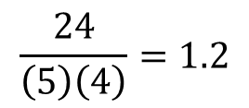
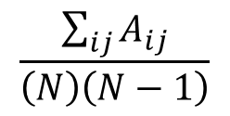
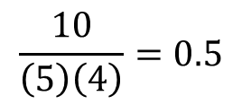
Social Network Metrics: Basic Volume
Density: Mean of the adjacency matrix
a
b
c
d
e
For most real-life social networks, density is hard to interpret because the denominator scales by the square of population. So average degree is often better.
1
b
2
3
d
1
a
--
1
0
0
0
a
c
5
e
b
1
--
2
0
0
c
0
2
--
3
5
d
0
0
3
--
1
e
0
0
5
1
--
a
b
c
d
e
a
--
1
0
0
0
b
1
--
1
0
0
c
0
1
--
1
1
d
0
0
1
--
1
e
0
0
1
1
--

Slide 53
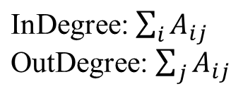
Social Network Metrics: Basic Volume
Degree: Number of links adjacent to a node
a
b
c
d
e
a
b
c
d
e
1
1
3
0
2
a
1
1
6
0
6
a
1
1
b
1
b
1
c
1
1
1
c
2
3
1
d
d
e
1
1
e
5
1
1 2 1 2 1 7
1 3 5 4 1 14

Slide 54
Social Network Metrics: Connectivity
Connectivity refers to how actors in one part of the network are connected to actors in another part of the network.
Reachability: is it possible for actor i to reach actor j? This can only be true if there is a chain of contact from one actor to another.
Distance: given they can be reached, how many steps are they from each other?
Redundancy: how many different paths connect each pair?

Slide 55
Social Network Metrics: Connectivity
Indirect connections are what make networks systems. One actor can reach another if there is a path in the graph connecting them.
b
d
a
b
f
a
c
e
c
f
d
e
Paths can be directed, leading to a distinction between strong and weak components

Slide 56
Social Network Metrics: Connectivity
Basic elements in connectivity
A path is a sequence of nodes and edges starting with one node and ending with another, tracing the indirect connection between the two. On a path, you never go backwards or revisit the same node twice.
Example: a → b → c→d
A walk is any sequence of nodes and edges, and may go backwards. Example: a → b → c → b →c →d
A cycle is a path that starts and ends with the same node. Example: a → b → c → a

Slide 57
Social Network Metrics: Connectivity
Reachability
If you can trace a sequence of relations from one actor to another, then the two are reachable. If there is at least one path connecting every pair of actors in the graph, the graph is connected and is called a component.
Intuitively, a component is the set of people who are all connected by a chain of relations.

Slide 58
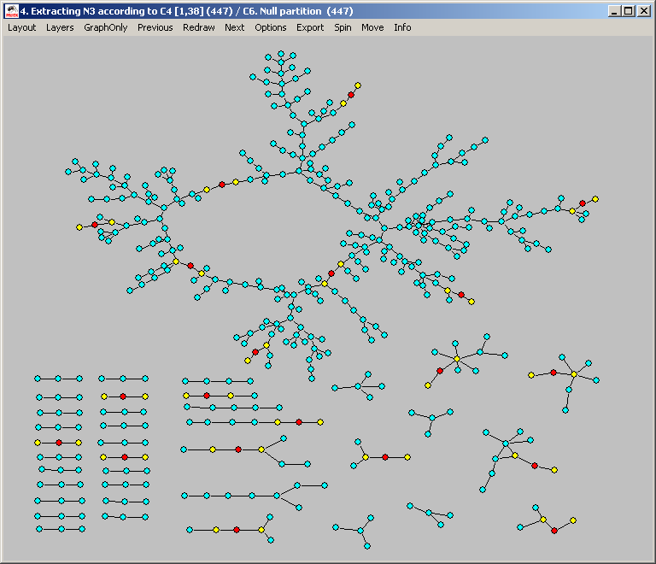
Social Network Metrics: Connectivity
This example contains many components.

Slide 59
Social Network Metrics: Connectivity
Because relations can be directed or undirected, components come in two flavors:
For a graph with any directed edges, there are two types of components:
Strong components consist of the set(s) of all nodes that are mutually reachable
Weak components consist of the set(s) of all nodes where at least one node can reach the other.

Slide 60
Social Network Metrics: Connectivity
There are only 2 strong components with more than 1 person in this network.
Components are the minimum requirement for social groups. As we will see later, they are necessary but not sufficient
All of the major network analysis software identifies strong and weak components

Slide 61
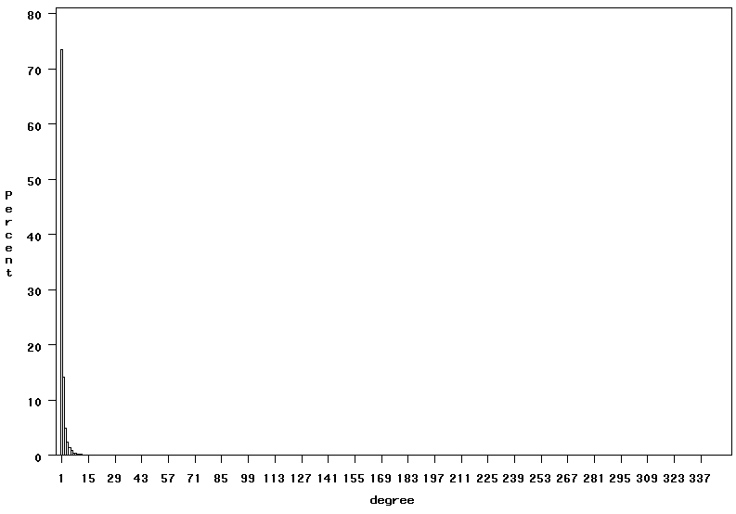
Social Network Metrics: Connectivity
Degree distributions
Many large networks are characterized by a highly skewed distribution of the number of partners (degree)
Notes:
It turns out that many observed networks have a characteristic involvement (degree) distribution, where a very small number of people have many ties, and most people have very few.
So most of us have 1 or 2 lifetime sex partners (far left of the graph), while a few NBA stars have many more (the far right).

Slide 62
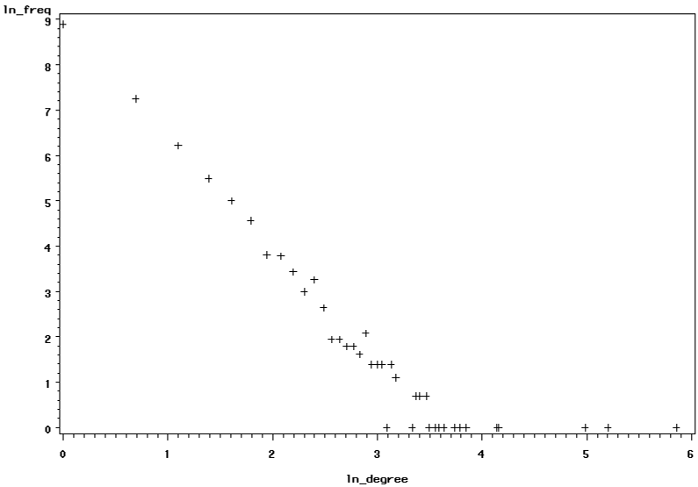
Social Network Metrics: Connectivity
Degree distributions
Many large networks are characterized by a highly skewed distribution of the number of partners (degree)
Notes:
This distribution is usually so skewed, that it makes sense to plot the histogram in log-log form, where the characteristic distribution then becomes clear. A power-law distribution often emerges, which has this functional form.

Slide 63

Social Network Metrics: Connectivity
Degree distributions
The scale-free model focuses on the distance-reducing capacity of high-degree nodes:

Slide 64

Social Network Metrics: Connectivity
Degree distributions
The scale-free model focuses on the distance-reducing capacity of high-degree nodes:
If a preferential attachment model is active, then high-degree nodes are hubs, that if removed can disconnect the network.
Since hubs are rare, PA networks are robust to random attack, but very fragile to targeted attack.

Slide 65

Social Network Metrics: Connectivity
Degree distributions
Colorado Springs High-Risk
(Sexual contact only)
Network is approximately scale-free, with λ = -1.3
But connectivity does not depend on the hubs.
PrefAttach→ Scale-free distribution, but scale-free distribution ^→ preferential attachment.
Notes:
An empirical example of interest to population types: The sexual contact network among high-risk actors in colorado springs. Most (mainly johns) have only one partner, but a few high-activity pros have many.

Slide 66

Social Network Metrics: Connectivity
Distance
Geodesic distance is measured by the smallest (weighted) number of relations separating a pair:
Actor “a” is:
1 step from 4
2 steps from 5
3 steps from 4
4 steps from 3
5 steps from 1
a
a

Slide 67
Social Network Metrics: Connectivity
Distance
When the graph is directed, distance is also directed (distance to vs distance from), following the direction of the tie.
a
k
m
a b c d e f g h i j k l m
------------------------------------------
a. . 1 2 . . . . . . . . 2 1
b. 3 . 1 . . . . . . . . 1 2
c. . . . . . . . . . . . . .
d. 4 3 1 . 1 2 1 . 2 . . 2 3
e. 3 2 2 1 . 1 2 . 1 . . 1 2
f. 4 3 3 2 1 . 3 . 2 . . 2 3
g. 5 4 4 3 2 1 . . 3 . . 3 4
h. . . . . . . . . 1 . . . .
i. . . . . . . . . . . . . .
j. . . . . . . . . 1 . . . .
k. . . . . . . . . 1 . . . .
l. 2 1 2 . . . . . . . . . 1
m. 1 2 3 . . . . . . . . 1 .
b
l
i
j
e
c
d
f
h
g

Slide 68
Social Network Metrics: Connectivity
Distance
Reachability in Colorado Springs
(Sexual contact only)
High-risk actors over 4 years
695 people represented
Longest path is 17 steps
Average distance is about 5 steps
Average person is within 3 steps of 75 other people
(Node size = log of degree)
Notes:
695 actors represented
Longest path is 17 steps
Average distance is about 5 steps
Average person is within 3 steps of 75 other people
137 people connected through 2 independent paths, core of 30 people connected through 4 independent paths

Slide 69
Measuring Networks: Connectivity
Distance
As a graph statistic, the distribution of distance can tell you a good deal about how close people are to each other (we’ll see this more fully when we get to closeness centrality).
The diameter of a graph is the longest geodesic, giving the maximum distance. We often use the l, or the mean distance between every pair to characterize the entire graph.
For example, all else equal, we would expect rumors to travel faster through settings where the average distance is small.

Slide 70
Measuring Networks: Connectivity
Redundancy (Local)
For a real network, people’s friends are not random, but clustered. We can modify the random equation by adjusting a, such that some portion of the contacts are random, the rest not. This adjustment is a ‘bias’ - I.e. a non-random element in the model -- that gives rise to the notion of ‘biased networks’. People have studied (mathematically) biases associated with:
Race (and categorical homophily more generally)
Transitivity (Friends of friends are friends)
Reciprocity (i--> j, j--> i)
There is still a great deal of work to be done in this area empirically, and it promises to be a good way of studying the structure of very large networks.

Slide 71

Measuring Networks: Connectivity
Redundancy (Local)
Local redundancy is known as “clustering” or “transitivity” - that one’s friends are friends with each other.
Density is the proportion of pairs tied, excluding ego.
Transitivity is the proportion of two-step ties that are closed (Friend of a Friend is a friend)
Transitivity
No ego
Density
Transitivity
0 0 0
0.4 0.71 1.0
0.7 0.78 .64
1 1 1

Slide 72




Measuring Networks: Connectivity
Redundancy (Global): Structural Cohesion
Structural Cohesion:
A network’s structural cohesion is equal to the minimum number of actors who, if removed from the network, would disconnect it.
0
1
2
3
Node Connectivity
As size of cut-set
Notes:
To illustrate, consider these four networks, each with an identical volume of social ties.
The graphs become more difficult to separate, and the number of independent paths increase. This is illustrated in the far left, where we can always trace at least 3 completely independent paths between every pair of people in the net.

Slide 73
Measuring Networks: Connectivity
Redundancy (Global): Structural Cohesion
Structural Cohesion:
A network’s structural cohesion is equal to the minimum number of actors who, if removed from the network, would disconnect it.
0
1
2
3
Node Connectivity
As number of node-independent paths
Notes:
To illustrate, consider these four networks, each with an identical volume of social ties.
The graphs become more difficult to separate, and the number of independent paths increase. This is illustrated in the far left, where we can always trace at least 3 completely independent paths between every pair of people in the net.

Slide 74


Measuring Networks: Connectivity
Redundancy (Global): Structural Cohesion
Sociogram
Nestedness Structure
Cohesive Blocks
Depth
1
1
8
3
4
2
5
2
9
3
6
4
7
5
Cohesive Blocking
The arrangement of subsequently more connected sets by branches and depth uniquely characterize the connectivity structure of a network

Slide 75
Measuring Networks
Centrality
Distance & Connectivity measures “locate” a node based on particular features of the path structure, but there are many other ways of locating nodes in networks.
Centrality refers to (one dimension of) location, identifying where an actor resides in a network.
For example, we can compare actors at the edge of the network to actors at the center.
In general, this is a way to formalize intuitive notions about the distinction between insiders and outsiders.
As a terminology point, some authors distinguish centrality from prestige based on the directionality of the tie. Since the formulas are the same in every other respect, I stick with “centrality” for simplicity.

Slide 76
Measuring Networks
Centrality
Conceptually, centrality is fairly straight forward: we want to identify which nodes are in the ‘center’ of the network. In practice, identifying exactly what we mean by ‘center’ is somewhat complicated, but substantively we often have reason to believe that people at the center are very important with respect to some pattern of flow/spread on the network.
The standard centrality measures capture a wide range of “importance” in a network:
Degree
Closeness
Betweenness
Eigenvector / Power measures
After discussing these, I will describe measures that combine features of each of them.

Slide 77
Measuring Networks
Centrality
..and just a teaser of all the elements we are leaving out:
Schoch lists over 100 different measures…

Slide 78




Measuring Networks
Centrality
The most intuitive notion of centrality focuses on degree. Degree is the number of direct contacts a person has. The ideas is that the actor with the most ties is the most important:

Slide 79

Measuring Networks
Centrality
Degree centrality, however, can be deceiving, because it is a purely local measure.

Slide 80
Measuring Networks
Centrality
If we want to measure the degree to which the graph as a whole is centralized, we look at the dispersion of centrality:
Simple: variance of the individual centrality scores.
Or, using Freeman’s general formula for centralization (which ranges from 0 to 1):
UCINET, SPAN, PAJEK and most other network software will calculate these measures.

Slide 81
Measuring Networks
Centrality
Degree Centralization Scores
Freeman: 1.0
Variance: 3.9
Freeman: 0.0
Variance: 0.0
Freeman: .02
Variance: .17
Freeman: .07
Variance: .20

Slide 82
Measuring Networks
Centrality
A second measure of centrality is closeness centrality. An actor is considered important if he/she is relatively close to all other actors.
Closeness is based on the inverse of the distance of each actor to every other actor in the network.
Closeness Centrality:
Normalized Closeness Centrality

Slide 83


Measuring Networks
Centrality
Closeness Centrality in the examples
Distance Closeness normalized
0 1 1 1 1 1 1 1 .143 1.00
1 0 2 2 2 2 2 2 .077 .538
1 2 0 2 2 2 2 2 .077 .538
1 2 2 0 2 2 2 2 .077 .538
1 2 2 2 0 2 2 2 .077 .538
1 2 2 2 2 0 2 2 .077 .538
1 2 2 2 2 2 0 2 .077 .538
1 2 2 2 2 2 2 0 .077 .538
Distance Closeness normalized
0 1 2 3 4 4 3 2 1 .050 .400
1 0 1 2 3 4 4 3 2 .050 .400
2 1 0 1 2 3 4 4 3 .050 .400
3 2 1 0 1 2 3 4 4 .050 .400
4 3 2 1 0 1 2 3 4 .050 .400
4 4 3 2 1 0 1 2 3 .050 .400
3 4 4 3 2 1 0 1 2 .050 .400
2 3 4 4 3 2 1 0 1 .050 .400
1 2 3 4 4 3 2 1 0 .050 .400

Slide 84

Measuring Networks
Centrality
Closeness Centrality in the examples
Distance Closeness normalized
0 1 2 3 4 5 6 .048 .286
1 0 1 2 3 4 5 .063 .375
2 1 0 1 2 3 4 .077 .462
3 2 1 0 1 2 3 .083 .500
4 3 2 1 0 1 2 .077 .462
5 4 3 2 1 0 1 .063 .375
6 5 4 3 2 1 0 .048 .286

Slide 85

Measuring Networks
Centrality
Closeness Centrality in the examples
Distance Closeness normalized
0 1 1 2 3 4 4 5 5 6 5 5 6 .021 .255
1 0 1 1 2 3 3 4 4 5 4 4 5 .027 .324
1 1 0 1 2 3 3 4 4 5 4 4 5 .027 .324
2 1 1 0 1 2 2 3 3 4 3 3 4 .034 .414
3 2 2 1 0 1 1 2 2 3 2 2 3 .042 .500
4 3 3 2 1 0 2 3 3 4 1 1 2 .034 .414
4 3 3 2 1 2 0 1 1 2 3 3 4 .034 .414
5 4 4 3 2 3 1 0 1 1 4 4 5 .027 .324
5 4 4 3 2 3 1 1 0 1 4 4 5 .027 .324
6 5 5 4 3 4 2 1 1 0 5 5 6 .021 .255
5 4 4 3 2 1 3 4 4 5 0 1 1 .027 .324
5 4 4 3 2 1 3 4 4 5 1 0 1 .027 .324
6 5 5 4 3 2 4 5 5 6 1 1 0 .021 .255

Slide 86

Measuring Networks
Centrality
Betweenness Centrality:
Model based on communication flow: A person who lies on communication paths can control communication flow, and is thus important. Betweenness centrality counts the number of shortest paths between i and k that actor j resides on.
b
a
C d e f g h

Slide 87
Measuring Networks
Centrality
Betweenness Centrality:
Where g_{jk} = the number of geodesics connecting jk, and
g_{jk}(n_{i}) = the number that actor i is on.
Usually normalized by:

Slide 88




Measuring Networks
Centrality
Betweenness Centrality:
Centralization: 1.0
Centralization: .59
Centralization: 0
Centralization: .31

Slide 89

Measuring Networks
Centrality
Betweenness Centrality:
Centralization: .183

Slide 90




Measuring Networks
Centrality
Information Centrality:
It is quite likely that information can flow through paths other than the geodesic. The Information Centrality score uses all paths in the network, and weights them based on their length.

Slide 91
Measuring Networks
Centrality
Comparing across these 3 centrality values
Generally, the 3 centrality types will be positively correlated
When they are not (low) correlated, it probably tells you something interesting about the network.
Low
Degree
Low
Closeness
Low
Betweenness
High Degree
Embedded in cluster that is far from the rest of the network
Ego's connections are redundant - communication bypasses him/her
High Closeness
Key player tied to important important/active alters
Probably multiple paths in the network, ego is near many people, but so are many others
High Betweenness
Ego's few ties are crucial for network flow
Very rare cell. Would mean that ego monopolizes the ties from a small number of people to many others.

Slide 92
Measuring Networks
Centrality
Bonacich Power Centrality: Actor’s centrality (prestige) is equal to a function of the prestige of those they are connected to. Thus, actors who are tied to very central actors should have higher prestige/ centrality than those who are not.
This is a variant of eigenvector centrality/pagerank.
α is a scaling vector, which is set to normalize the score.
β reflects the extent to which you weight the centrality of people ego is tied to.
R is the adjacency matrix (can be valued)
I is the identity matrix (1s down the diagonal)
1 is a matrix of all ones.

Slide 93
Measuring Networks
Centrality
Bonacich Power Centrality:
The magnitude of β reflects the radius of power. Small values of β weight local structure, larger values weight global structure.
If β is positive, then ego has higher centrality when tied to people who are central.
If β is negative, then ego has higher centrality when tied to people who are not central.
As β approaches zero, you get degree centrality.

Slide 94
Measuring Networks
Centrality
Bonacich Power Centrality:
β = 0.23

Slide 95

Measuring Networks
Community Detection
A primary interest in Social Network Analysis is the identification of “significant social subgroups” – some smaller collection of nodes in the graph that can be considered, at least in some senses, as a “unit” based on the pattern, strength, or frequency of ties.
There are many ways to identify groups. They all insist on a group being in a connected component, but other than that the variation is wide.

Slide 96
Measuring Networks
Community Detection
A) Graph theoretical methods: Cliques and extensions of cliques
Cliques
k-cores
k-plexes
Freeman (1992) Models
K-components
B) Algorithmic methods: search through a network trying to maximize for a particular pattern. Adjust assignment of actors to groups until a particular pattern of ties (block diagonal, usually) is identified.
Standard models:
Factions (UCI-NET)
NEGOPY (Richards)
KliqueFinder (Frank)
RNM, JIGGLE (Moody)
Betweeness Centrality (Newman)
Agglomerative clustering (Blondel & variants)

Slide 97

Measuring Networks
Community Detection
Graph Theoretical Models.
Start with a clique. A clique is defined as a maximal subgraph in which every member of the graph is connected to every other member of the graph. Cliques are collections of nodes where density = 1.0.
Properties of cliques:
Density: 1.0
Everyone connected to n-1 alters
Distance between every pair is 1
Ratio of within group ties to between group ties is infinite
All triads are transitive

Slide 98

Measuring Networks
Community Detection
Graph Theoretical Models.
In practice, complete cliques are not very useful. They tend to overlap heavily and are limited in their size.
Graph theorists have thus relaxed the complete connectivity requirement (with varying degrees of success). See the Moody & White (2003) for a discussion of these attempts.

Slide 99

Measuring Networks
Community Detection
Graph Theoretical Models.
k-cores: Every person connected to at least k other people.
Ideally, they would look something like this (here two 3-cores).
However, adding a single tie from A to B would make the whole graph a 3-core

Slide 100
Measuring Networks
Community Detection
Extensions of this idea include:
K-Core: Every person has ties to at least k other people in the set.
K-plex: Every member connected to at least n-k other
people in the graph (recall in a clique everyone is connected to n-1, so this relaxes that condition.
n-clique: Every person is connected by a path of N or less (recall a clique is with distance = 1).
N-clan: same as an n-clique, but all paths must be inside the group.
I’ve never had much luck with any of these methods empirically. Real data is usually too messy to work well. Since many of the graph-theoretic options seem not to work well, authors have used optimization techniques, that attempt to identify groups iteratively.

Slide 101
Measuring Networks
Community Detection
Algorithmic Approaches to Identifying Primary Groups:
1) Measures of fit
To identify a primary group, we need some measure of how clustered the network is. Usually, this is a function of the number of ties that fall within group to the number of ties that fall between group.
2) Processes designed to maximize (1)
Once we have such an index, we need a method for searching through the network to maximize the fit.

Slide 102

Measuring Networks
Community Detection
Modularity is probably the most commonly used contemporary clustering metric
Where:
m is number of edges
k is degree
A is the adjacency matrix, so A_{ij} is tie value
δ(CiCj) is indicator for being in the same group
γ is a resolution parameter
Intuitively this is the
Notes:
𝑄=∑2_𝑖𝑗▒〖1/2𝑚 (𝐴_𝑖𝑗−𝛾 (𝐾_𝑖 𝐾_𝑗)/2𝑚) 〗 𝛿(𝐶_𝑖 𝐶_𝑗)
Where m is the number of edges, k is the degree, A is the adjacency matrix, d is an indicator for whether node i and j are in the same subgroup or not, and g is a “resolution parameter” that identifies the scale at which clustering is observed (Fortunato and Barthelemy 2007; Reichardt and Bornholdt, 2006). Substantively, [k_{i}k_{j}/2m] represents the null model – the expected likelihood of contact between nodes – here simply dependent on the degrees of the pair, so (A_{ij} - [𝛾 (𝐾_𝑖 𝐾_𝑗)/2𝑚]) is the connectivity above random expectation, normalized by the total volume of ties in the network.

Slide 103
Measuring Networks
Community Detection
Modularity is probably the most commonly used contemporary clustering metric
Normalizing
constant
Resolution parameter
Observed ties
Expected ties
Indicator for same group (0,1)
Intuitively this is the
Notes:
𝑄=∑2_𝑖𝑗▒〖1/2𝑚 (𝐴_𝑖𝑗−𝛾 (𝐾_𝑖 𝐾_𝑗)/2𝑚) 〗 𝛿(𝐶_𝑖 𝐶_𝑗)
Where m is the number of edges, k is the degree, A is the adjacency matrix, d is an indicator for whether node i and j are in the same subgroup or not, and g is a “resolution parameter” that identifies the scale at which clustering is observed (Fortunato and Barthelemy 2007; Reichardt and Bornholdt, 2006). Substantively, [k_{i}k_{j}/2m] represents the null model – the expected likelihood of contact between nodes – here simply dependent on the degrees of the pair, so (A_{ij} - [𝛾 (𝐾_𝑖 𝐾_𝑗)/2𝑚]) is the connectivity above random expectation, normalized by the total volume of ties in the network.

Slide 104





Measuring Networks
Community Detection
Modularity Scores Comparison to Segregation Index – comparing value of multiple solutions on the same network
Q=0.24
Q=0.51
Q=0.68

Slide 105
Measuring Networks
Community Detection
Other indices include:
The ratio of in-group to out-group ties (Negopy, UCINET Factions)
Maximizing the probability of in-group contact (CliqueFinder)
The Segregation Matrix Index (SMI)
The dyadic factor loadings for overlapping groups (akin to a latent class model)
Minimize the within-group distance
Once a metric has been chosen, some algorithm is needed to search through the graph to identify clusters. The search problem itself – find the partition that optimizes modularity – is NP hard. So we have many heuristic options.
For a good general off-the-shelf algorithm, I recommend the Louvain model or Walktrap. For those familiar with SVD or Factor analysis, running a simple latent-factor model on the distance matrix is a not-awful first-cut and links directly with a rich literature on spectral methods for community detection.

Slide 106
Measuring Networks
Community Detection
The best “off the shelf” programs for identifying subgroups for social networks based on modularity are probably:
Louvain method: Blondel, Vincent D. Jean-Loup Guillaume, Renaud Lambiotte and Etienne Lefebvre. 2008. “Fast unfolding of communities in large networks” Journal of Statistical Mechanics. stacks.iop.org/JSTAT/2008/P10008
- in PAJEK and R
The “Edge-Betweenness” model: Girvan M. and Newman M. E. J., Community structure in social and biological networks, Proc. Natl. Acad. Sci. USA 99, 7821-7826 (2002).
- in R – but only for small networks!
For those familiar with SVD or Factor analysis, running a simple latent-factor model on the distance matrix is a not-awful first-cut and links directly with a rich literature on spectral methods for community detection.

Slide 107

Measuring Networks
Community Detection
Gangon Prison Network
In practice, the different algorithms will give different results.
Here, I compare NEGOPY, FACTIONS and RNM. Groups A and B are identical, C is close. F, E and D differ.
It’s usually a good idea to explore multiple solutions and algorithms.
(all solutions constrained to 6 groups)

Slide 108
Measuring Networks
Community Detection
What about that resolution parameter?
This is a nob that governs the number of clusters one finds in the network. Large values give you many small clusters, small values give you a few big clusters.
There is no real good theoretical reason to pick one value over another; best choice is to do a search over a wide range. Typical search values are something like 0.5 to 4 or some such…
Note that, right now, The iGraph tools in R do not include a way to specify this. But you can use self-loops on Aij to do the same thing. See Shai

Slide 109

Measuring Networks
Community Detection
What about that resolution parameter?
Granell, B., Gomez, S., & Arenas, A. (2011). Mesoscopic analysis of networks: Applications to exploratory analysis and data clustering. Chaos, 21(1), 016102.

Slide 110

Measuring Networks
Community Detection
What about that resolution parameter?
William H. Weir, Scott Emmons, Ryan Gibson, Dane Taylor, and Peter J. Mucha. Post-processing partitions to identify domains of modularity optimization. Algorithms, 2017. URL: http://www.mdpi.com/1999-4893/10/3/93, doi:10.3390/a10030093.

Slide 111
Measuring Networks
Community Detection
All of these techniques are inductive procedures. It is possible to specify a deductive, test for group membership, if you have a prior reasons to assume that a particular set of people are a group.
The simplest way would be to specify a dyadic model on the adjacency matrix, then model the probability (strength) of a tie as a function of dyadic characteristics and your indicator for being in the same group. If this parameter is large and significant, then you have evidence for the group (this is an ERG model, btw. See part III).
This is, in fact, what KliqueFinder (Ken Frank’s program) does inductively….
…and if you move from an explicit group to a Latent group, you get the Hoff Model from LatentNet (in R).

Slide 112
Measuring Networks
Community Role Detection
Elements of a Role:
Rights and obligations with respect to other people or classes of people
Roles require a ‘role compliment’ another person who the role-occupant acts with respect to
Examples:
Parent – child
Teacher – student
Lover – lover
Friend – Friend
Husband - Wife
Nadel (Following functional anthropologists and sociologists) defines ‘logical’ types of roles, and then examines how they can be linked together.

Slide 113
Measuring Networks
Community Role Detection
White et al: From logical role systems to empirical social structures
Start with some basic ideas of what a role is: An exchange of something (support, ideas, commands, etc) between actors. Thus, we might represent a family as:
P
P
C
C
C
Romantic Love
Provides food for
Bickers with
(and there are, of course, many other relations inside a family)

Slide 114
Measuring Networks
Community Role Detection
Blockmodeling: basic steps
In any positional analysis, there are 4 basic steps:
1) Identify a definition of equivalence
2) Measure the degree to which pairs of actors are equivalent
3) Develop a representation of the equivalencies
4) Assess the adequacy of the representation
At the end of the day, this is community detection on a role-similarity matrix rather than an adjacency matrix.

Slide 115

Measuring Networks
Community Role Detection
If the model is going to be based on asymmetric or multiple relations, you simply stack the various relations, usually including both “directions” of asymmetric relations:
P
P
Sim
1 1 0 0 0
1 1 0 0 0
0 0 1 1 1
0 0 1 1 1
0 0 1 1 1
C
C
C
Romantic Love
Provides food for
Bickers with

